Slide 1

CLUSTERING
ADVANCED DATA SCIENCE TRAINING I
“Data science does not replace statistical modeling and data analysis; it augments them.”
(P. Boily)
“Data is not information, information is not knowledge, knowledge is not understanding, understanding is not wisdom.”
(attributed to Cliff Stoll in Keeler's Nothing to Hide: Privacy in the 21st Century, 2006)
data-action-lab.com

Slide 2
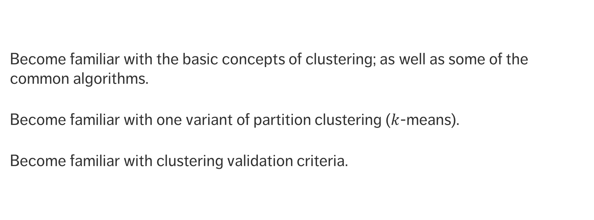
Learning Objectives
Become familiar with the basic concepts of clustering; as well as some of the common algorithms.
Become familiar with one variant of partition clustering ($k$-means).
Become familiar with clustering validation criteria.

Slide 3
CONTENTS
Case Study: OK Cupid
Clustering Basics
Clustering Algorithms
Clustering Validation
Notes
Example: Irises

Slide 4
CASE STUDY: OK Cupid Data
CLUSTERING
Finding true love via clustering analysis
(K.Poulsen, How a Math Genius Hacked OK Cupid to Find True Love, WIRED)

Slide 5
Context
Chris McKinlay, a 35 year old UCLA Math PhD Student, was looking for a romantic partner online with little luck
OK Cupid algorithms use only the questions that both potential matches decide to answer, and the questions he had chosen (more or less at random up to that point) were not popular
Between June 2012 and December 2013, he
used statistical sampling to find questions which mattered to the kind of partner he had in mind;
constructed a new profile that answered only those questions;
matched only with women in LA who might be right for him.

Slide 6
Process
This story provides a great example of the data mining process, from start to finish:
Collect data
Collect more and slightly better and different data
Collect still more data
Figure out a data mining technique that would be relevant to what he wanted to know (clustering)
Validate the results of the analysis

Slide 7
Process
This story provides a great example of the data mining process, from start to finish (continued):
Investigate the results, and narrow down which results were actually interesting
Analyze the interesting results some more, and use this to solve the original problem
Use the data to improve other areas of his profile as well
Sit back and reap the benefits of data mining?

Slide 8
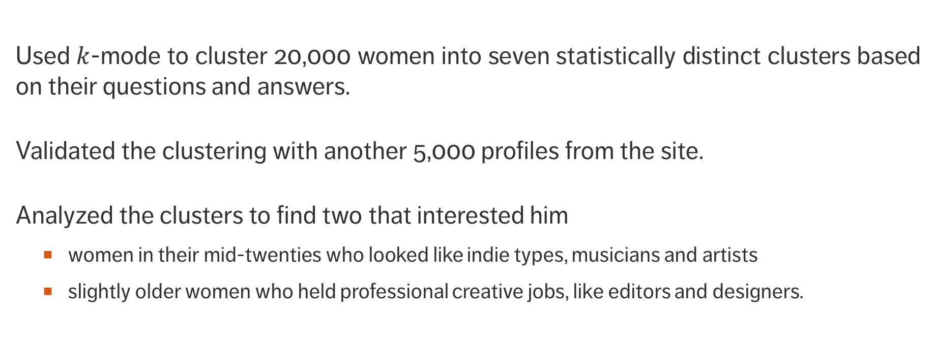
Methodology and Results
Used $k$-mode to cluster 20,000 women into seven statistically distinct clusters based on their questions and answers.
Validated the clustering with another 5,000 profiles from the site.
Analyzed the clusters to find two that interested him
women in their mid-twenties who looked like indie types, musicians and artists
slightly older women who held professional creative jobs, like editors and designers.

Slide 9
Methodology and Results
Used adaptive boosting (a machine-learning algorithm) to derive which questions he should answer in his profile.
More people appeared as matches based on his profile, leading to more first dates, some second dates, and a lone third date.
In the end, he was contacted by someone who was intrigued by his profile.
She asked him out and they were living together when the article was written.

Slide 10
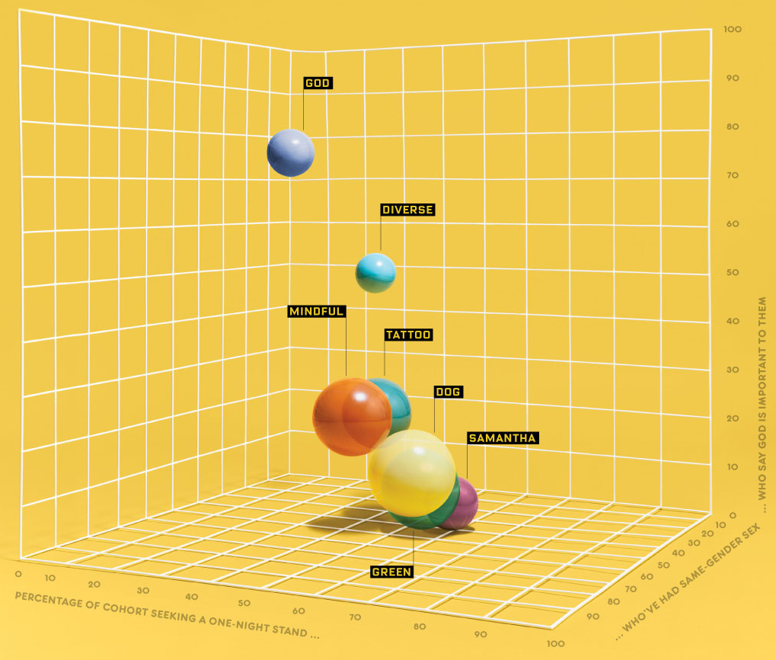

Slide 11
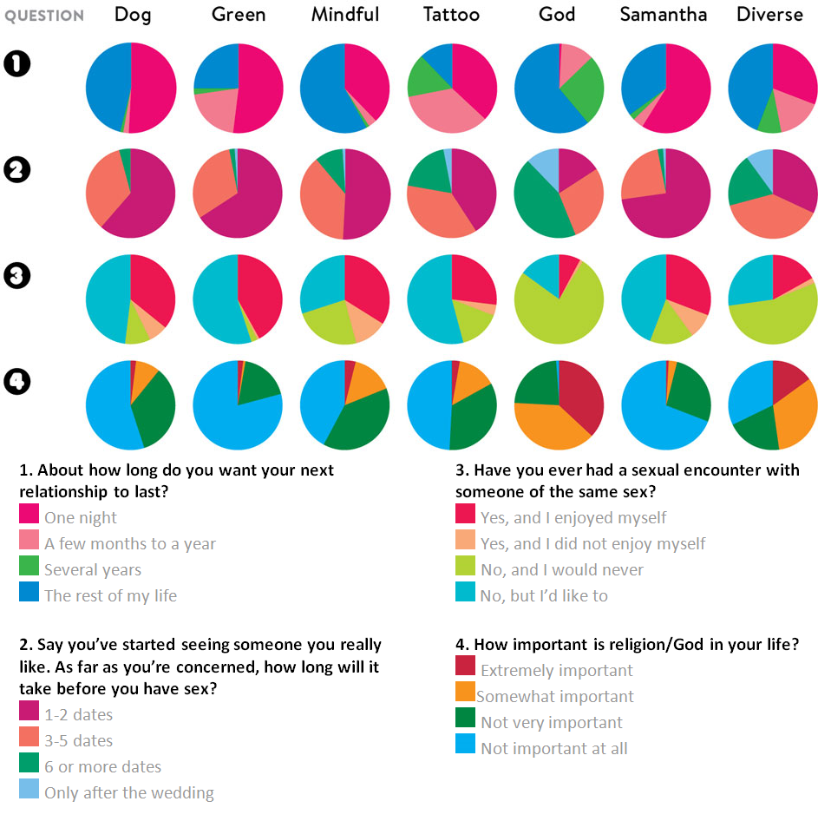

Slide 12
DISCUSSION
How do you feel about this use of machine learning?
Notes:
Intro to text analysis
We will be talking about data reduction using NHL game between Ottawa Senators vs. Toronto Maple Leafs on February 18th of 2017

Slide 13
Clustering Basics
CLUSTERING
“The Milky Way is nothing but a mass of innumerable stars planted together in clusters.”
(Galileo Galilei, Sidereus Nuncius)

Slide 14
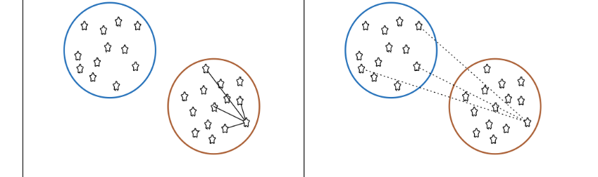
Clustering Overview
In clustering, the data is divided into naturally occurring groups. Within each group, the data points are similar; from group to group, they are dissimilar.
average distance to points in own cluster (low is good)
average distance to points in neighbouring cluster (high is good)
The grouping labels are not determined ahead of time, so clustering is an example of unsupervised learning.

Slide 15
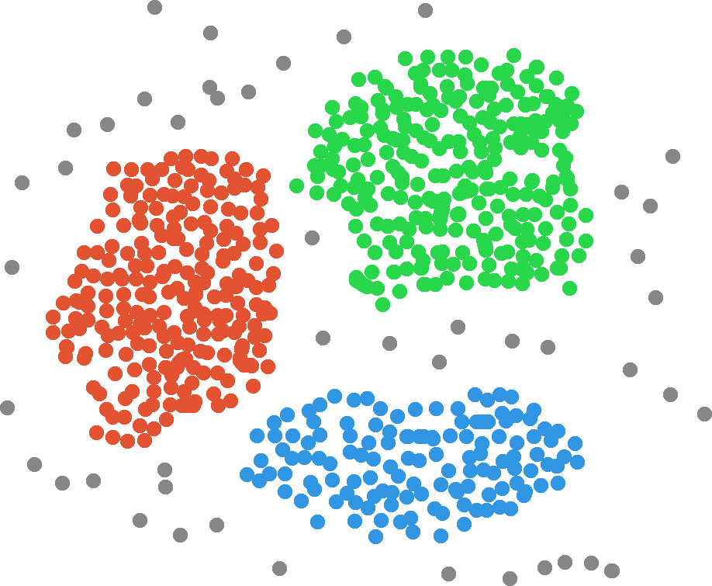
Income
Customers
Clusters
Age

Slide 16
Clustering Overview
Clustering is a relatively intuitive concept for human beings as our brains do it unconsciously
facial recognition
searching for patterns, etc.
In general, people are very good at messy data, but computers and algorithms have a harder time.
Part of the difficulty is that there is no agreed-upon definition of what constitutes a cluster:
“I may not be able to define what it is, but I know one when I see one”

Slide 17
Clustering Overview
Clustering algorithms can be complex and non-intuitive, based on varying notions of similarities between observations.
in spite of that, the temptation to explain clusters a posteriori is strong
They are also (typically) non-deterministic:
the same algorithm, applied twice (or more) to the same dataset, can discover completely different clusters
the order in which the data is presented can play a role
so can starting configurations

Slide 18
DISCUSSION
What does this (potential) non-repeatability imply for validation?
Notes:
Intro to text analysis
We will be talking about data reduction using NHL game between Ottawa Senators vs. Toronto Maple Leafs on February 18th of 2017

Slide 19
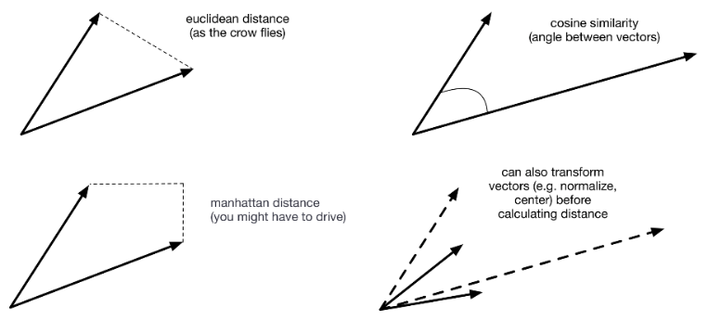
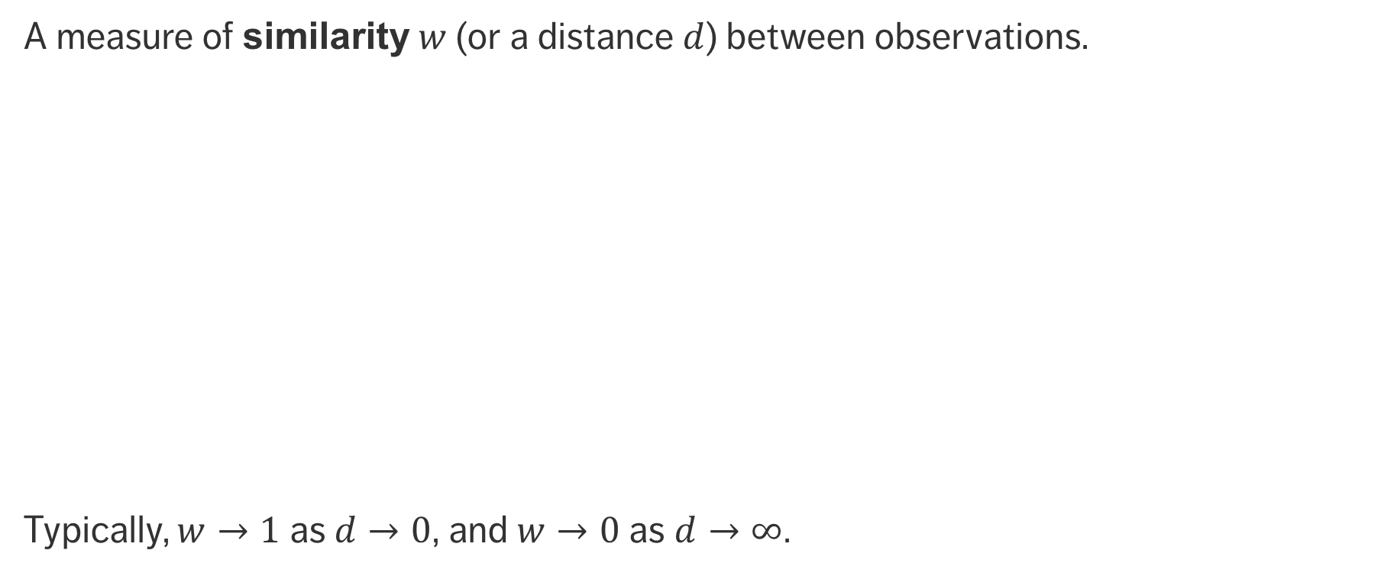
Clustering Requirement
A measure of similarity $w$ (or a distance $d$) between observations.
Typically, $w→1$ as $d→0$, and $w→0$ as $d→∞$.
Euclidean distance (as the crow flies)
Cosine distance (angle between vectors)
Manhattan distance (you might have to drive)
Transform (normalize, center) before calculating distance

Slide 20
Applications
Text Documents
grouping similar documents according to their topics, based on the patterns of common and unusual words
Product Recommendations
grouping online purchasers based on the products they have viewed, purchased, liked, or disliked
grouping products based on customer reviews
Marketing and Business
grouping client profiles based on their demographics and preferences

Slide 21
Other Uses
Dividing a larger group (or area, or category) into smaller groups, with members of the smaller groups guaranteed to have similarities of some kind.
tasks may then be solved separately for each of the smaller groups
this may lead to increased accuracy once the separate results are aggregated
Creating (new) taxonomies on the fly, as new items are added to a group of items
this would allow for easier product navigation on a website like Netflix, for instance.

Slide 22
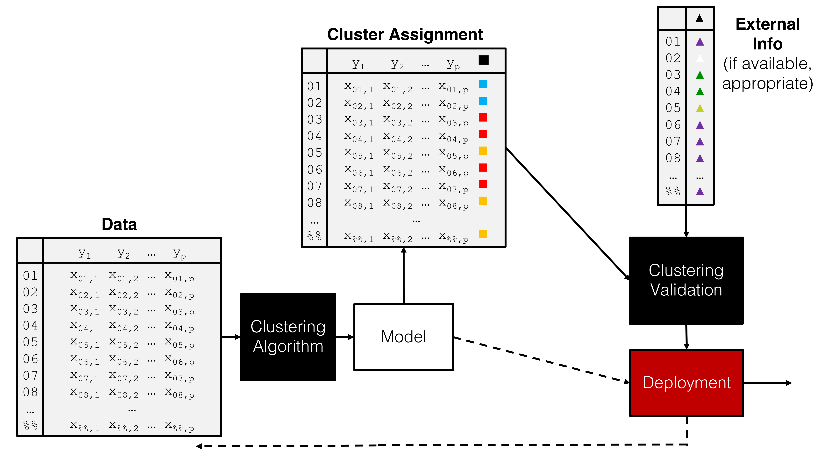

Slide 23
Clustering Algorithms
CLUSTERING
“Clustering is in the eye of the beholder, and as such, researchers have proposed many induction principles and models whose corresponding optimization problem can only be approximately solved by an even larger number of algorithms.”
(V. Estivill-Castro, Why So Many Clustering Algorithms?)

Slide 24
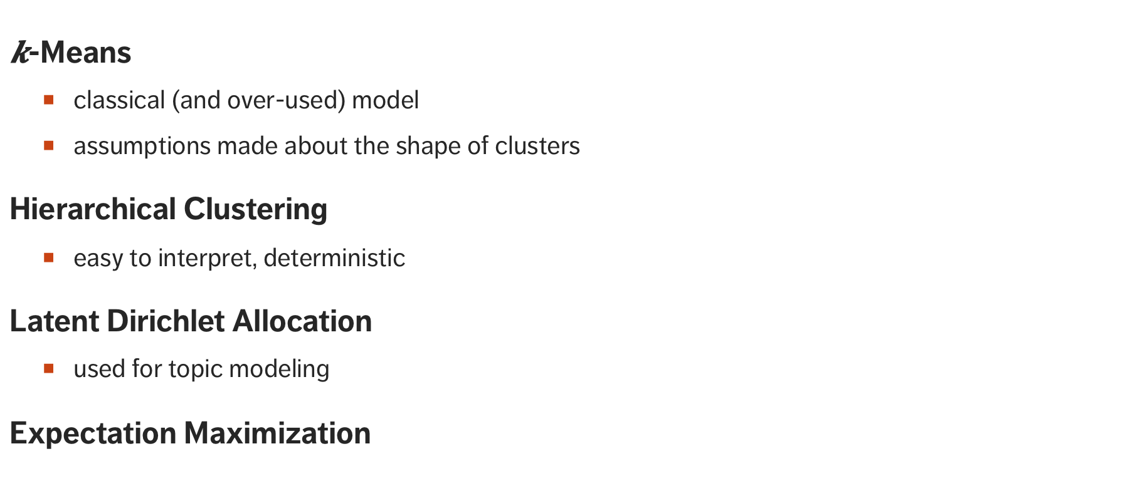
Clustering Schemes
$k$-Means
classical (and over-used) model
assumptions made about the shape of clusters
Hierarchical Clustering
easy to interpret, deterministic
Latent Dirichlet Allocation
used for topic modeling
Expectation Maximization

Slide 25
Clustering Schemes
Balanced Iterative Reducing and Clustering using Hierarchies
aka BIRCH
Density-Based Spatial Clustering of Applications with Noise
graph-based
Affinity Propagation
selects the optimal number of clusters automatically
Spectral Clustering
recognizes non-blob clusters

Slide 26
The General Form of a Clustering Algorithm

Slide 27
A Comparison Of Start States of Some Common Clustering Algorithms
This gives a sense of why clustering results can be very different for different algorithms.

Slide 28
A Comparison Of Intermediate States of Common Clustering Algorithms
This gives a sense of why clustering results can be very different for different algorithms.

Slide 29
K-means Algorithm Gloss

Slide 30
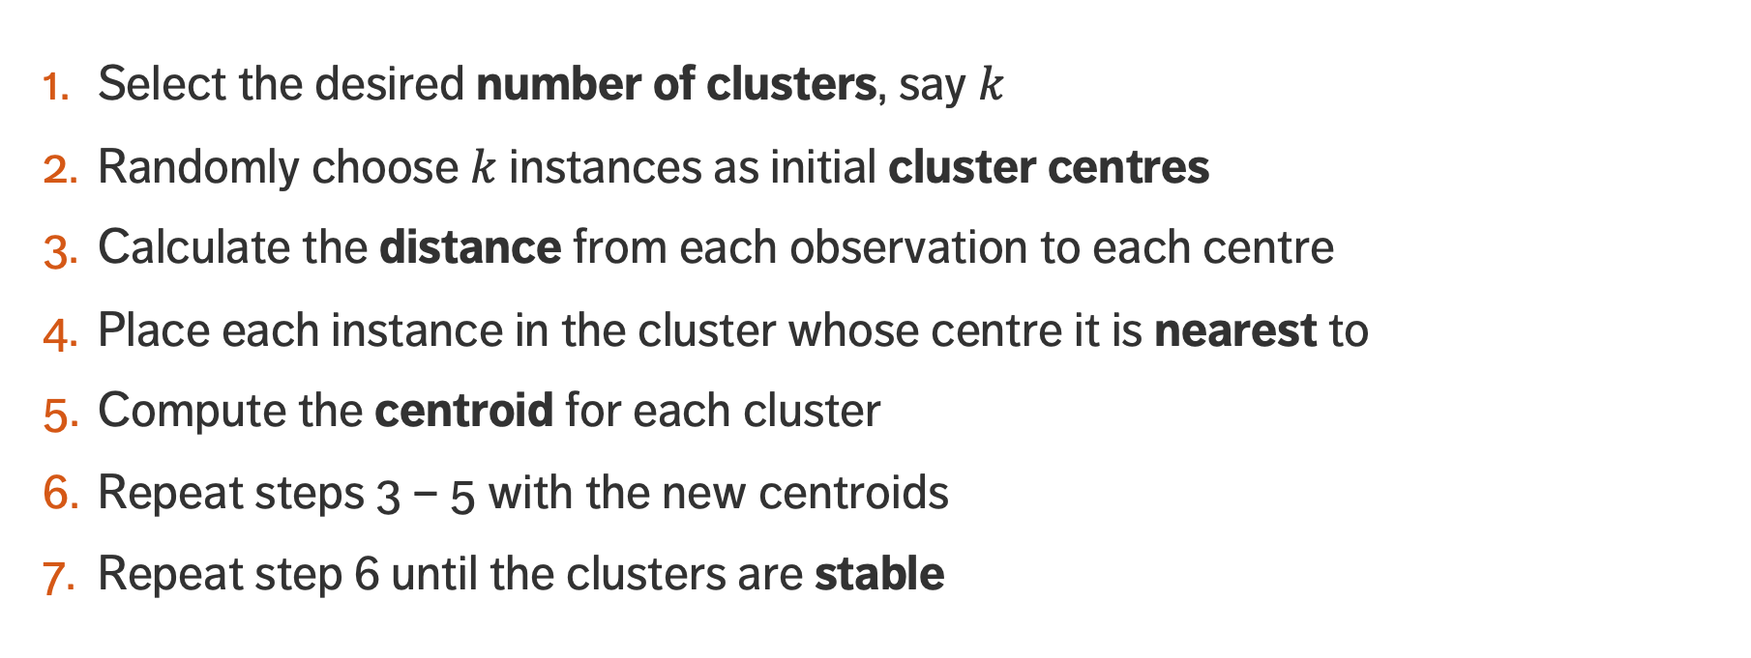
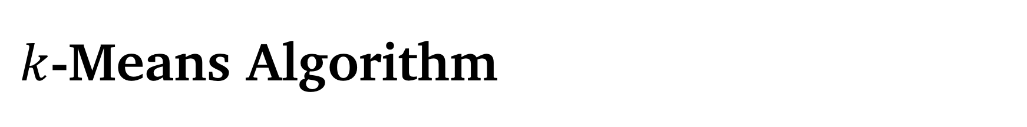
$k$-Means Algorithm
Select the desired number of clusters, say $k$
Randomly choose $k$ instances as initial cluster centres
Calculate the distance from each observation to each centre
Place each instance in the cluster whose centre it is nearest to
Compute the centroid for each cluster
Repeat steps 3 – 5 with the new centroids
Repeat step 6 until the clusters are stable

Slide 31
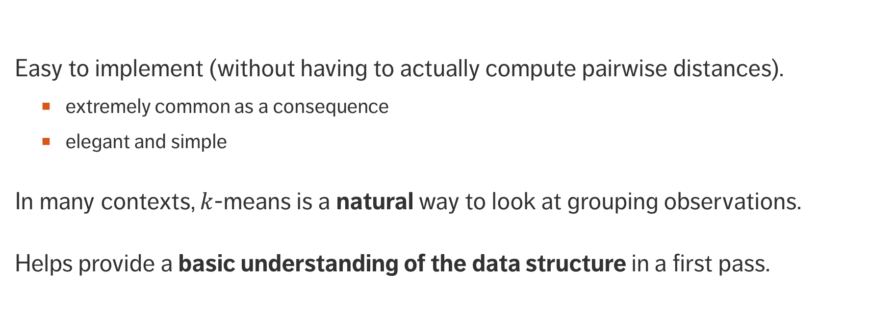
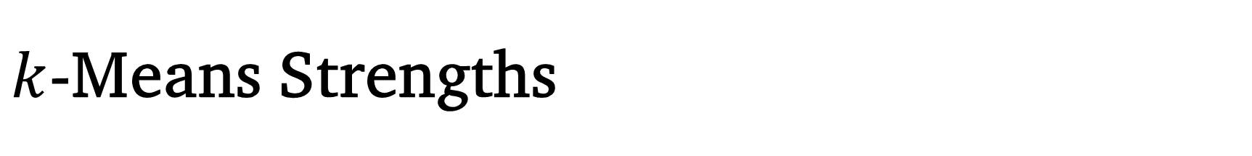
$k$-Means Strengths
Easy to implement (without having to actually compute pairwise distances).
extremely common as a consequence
elegant and simple
In many contexts, $k$-means is a natural way to look at grouping observations.
Helps provide a basic understanding of the data structure in a first pass.

Slide 32
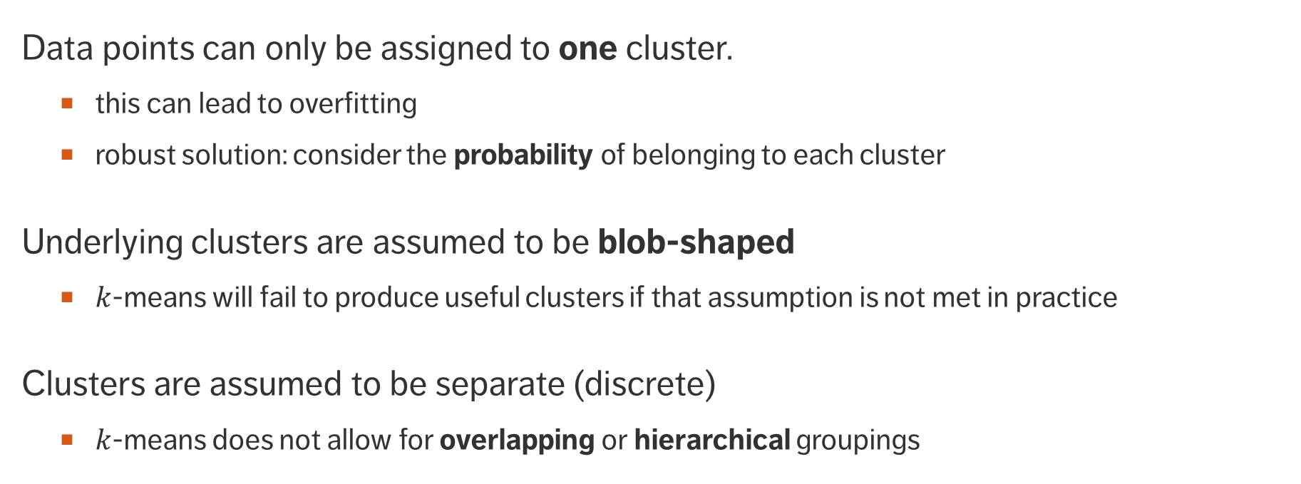
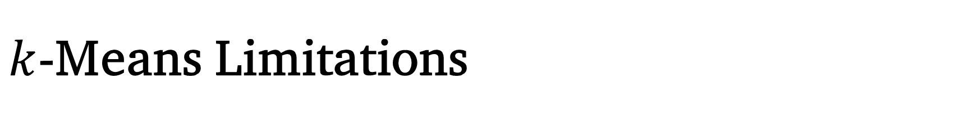
$k$-Means Limitations
Data points can only be assigned to one cluster.
this can lead to overfitting
robust solution: consider the probability of belonging to each cluster
Underlying clusters are assumed to be blob-shaped
$k$-means will fail to produce useful clusters if that assumption is not met in practice
Clusters are assumed to be separate (discrete)
$k$-means does not allow for overlapping or hierarchical groupings

Slide 33
Expectation Maximization Algorithm Gloss

Slide 34
DBSCAN Algorithm Gloss

Slide 35
AFFINITY PROPAGATION
Gloss

Slide 36
DISCUSSION
In what way does the choice of the algorithm(s) (and distance metric and associated parameters) depend on the available data and data types?
Notes:
Intro to text analysis
We will be talking about data reduction using NHL game between Ottawa Senators vs. Toronto Maple Leafs on February 18th of 2017

Slide 37
Clustering Validation

Slide 38
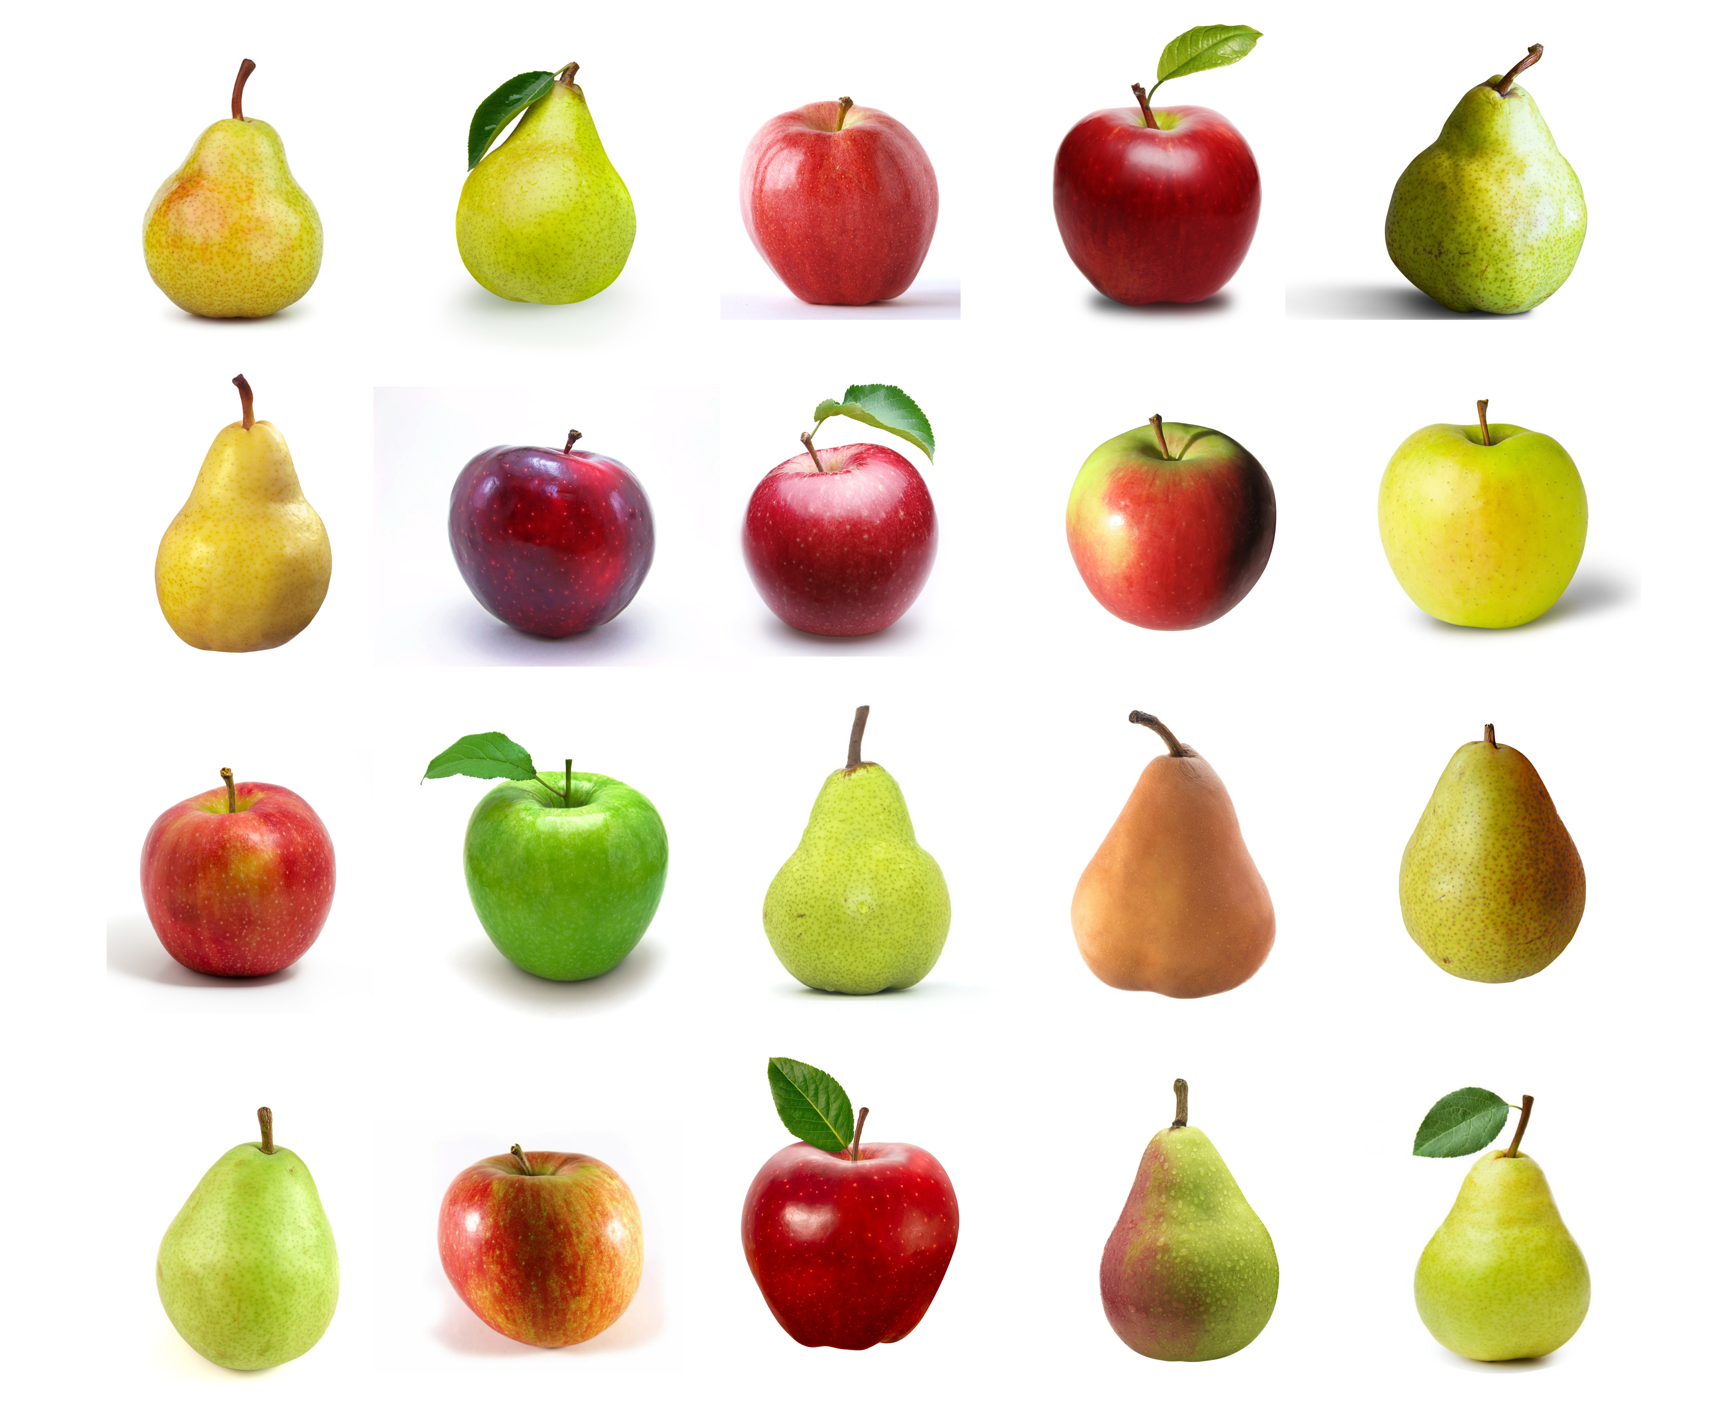
Fruit Image Dataset
20 images of fruit
Are there right or wrong groupings of this dataset?
Are there multiple possible ‘natural’ clusterings?
Could different clusterings be used differently?
Will some clusterings be of (objectively) higher quality than others?

Slide 39
Making Concepts Concrete
To appreciate clustering validation, it helps to relate the concepts to something tangible.
In what follows, take the time to think about how the presented concepts can be related to the images from this small dataset.

Slide 40
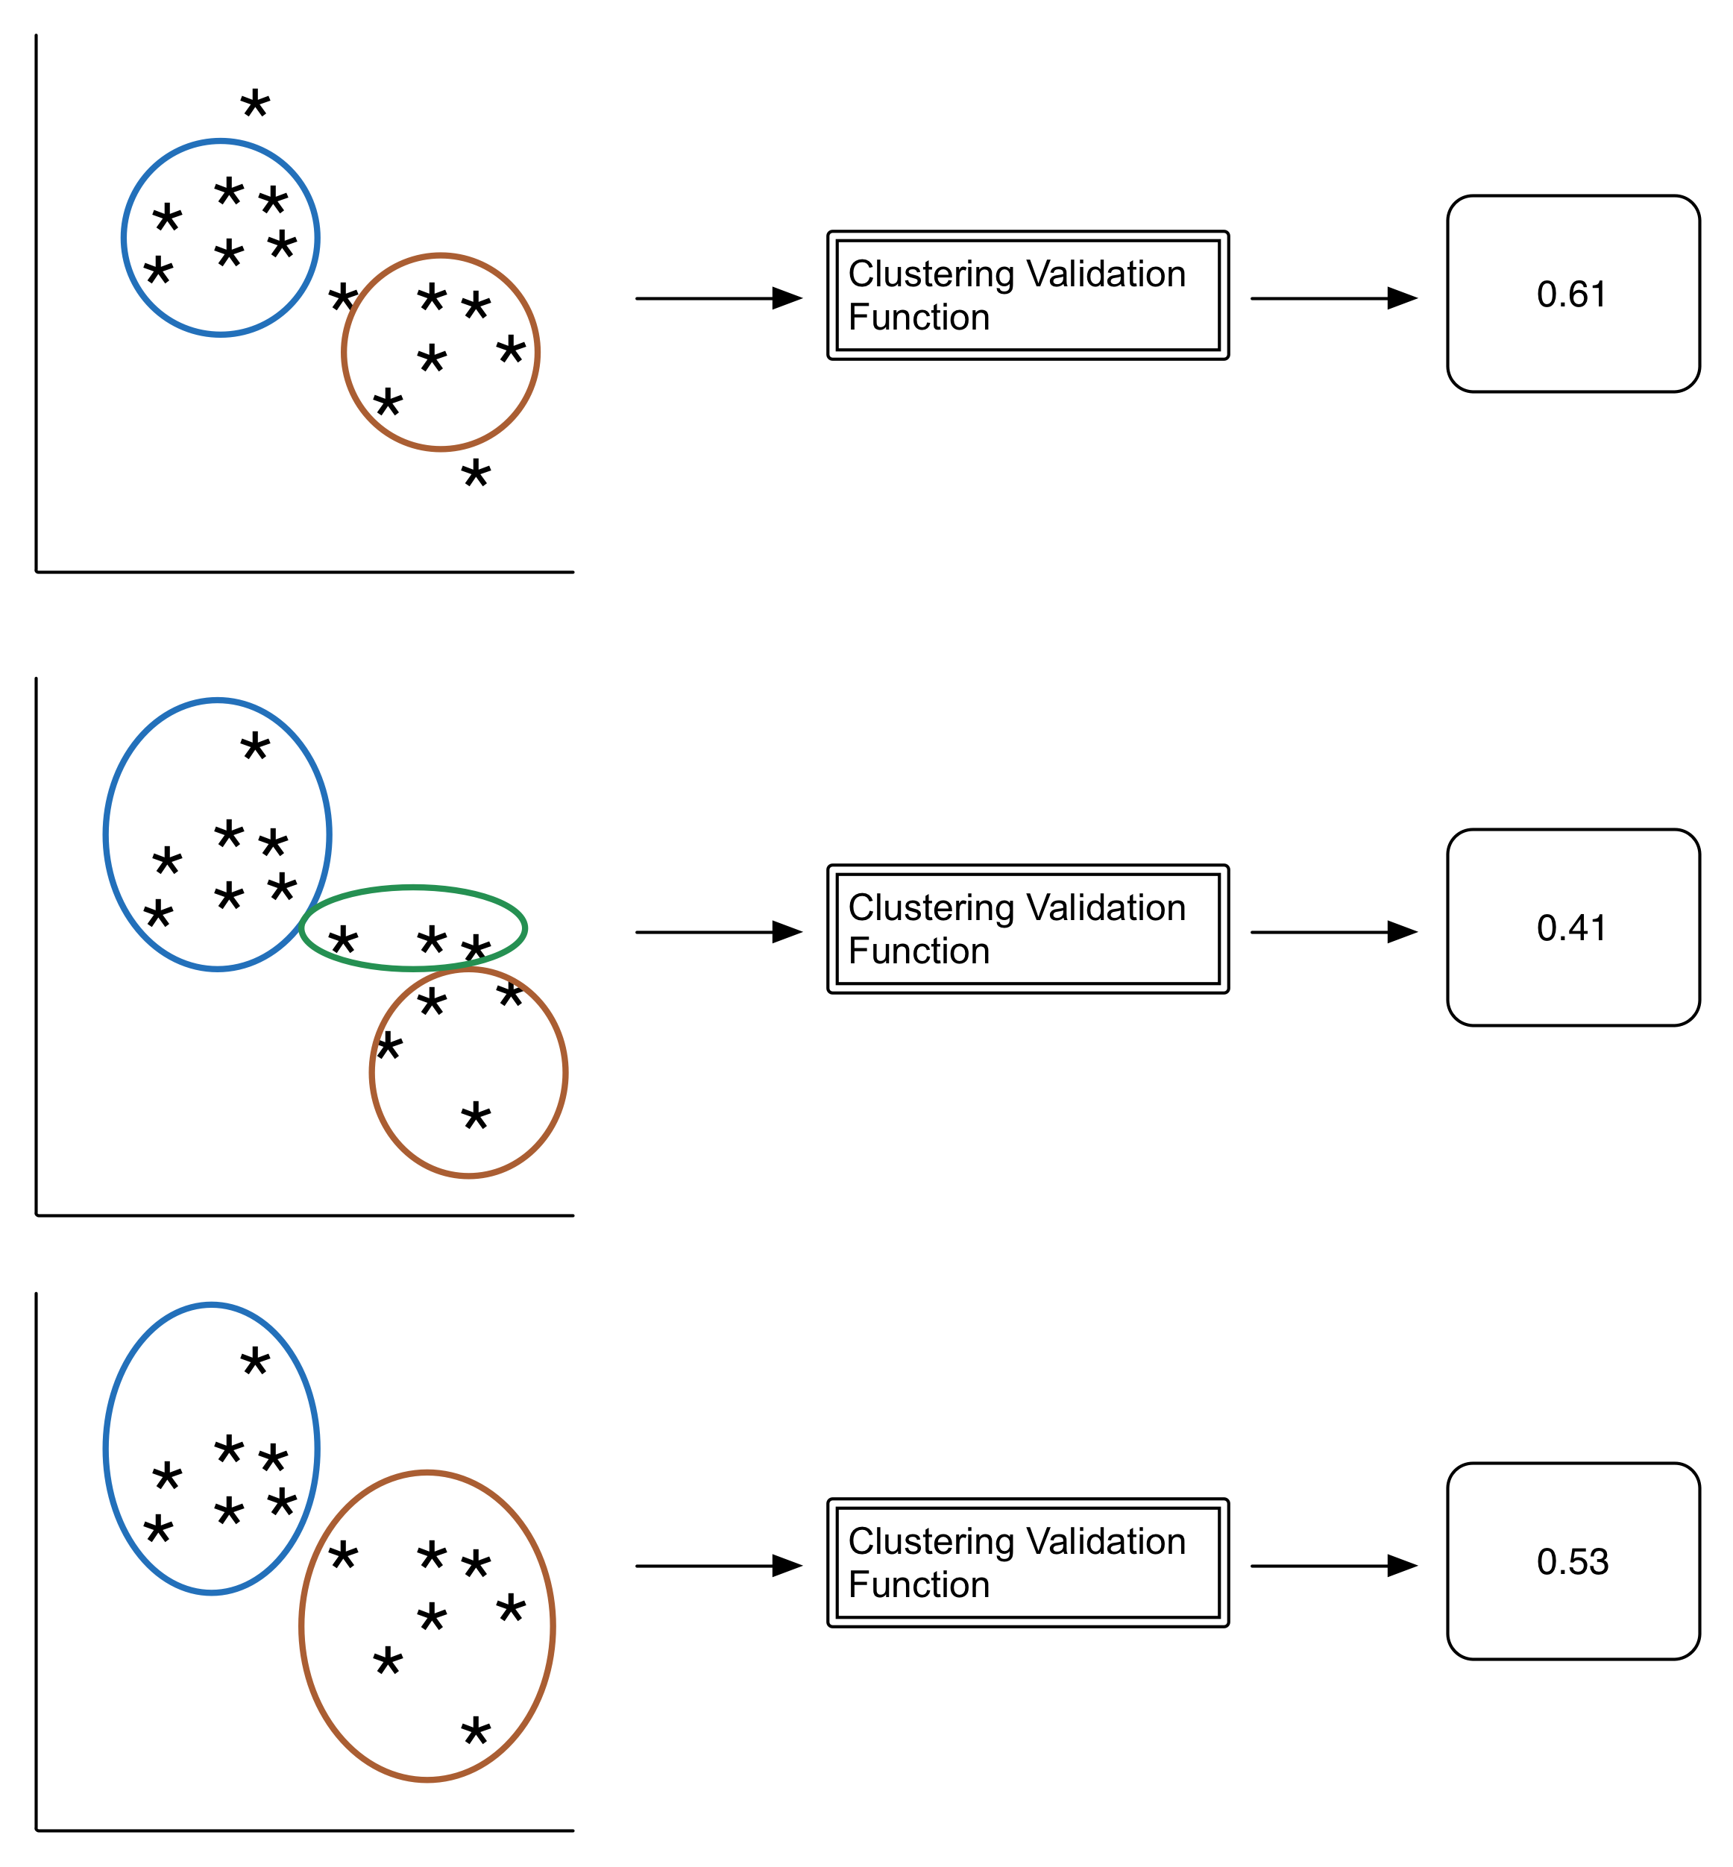
CLUSTERING VALIDATION
Clustering involves two main activities
Creating clusters
Assessing cluster quality
We create functions to carry out both of these activities
Clustering functions
Input: Instances (vectors)
Output: Cluster assignment to each instance
Assessing cluster quality
Input: Instances + Cluster Assignments (+ similarity matrix, usually)
Output: A numeric value

Slide 41
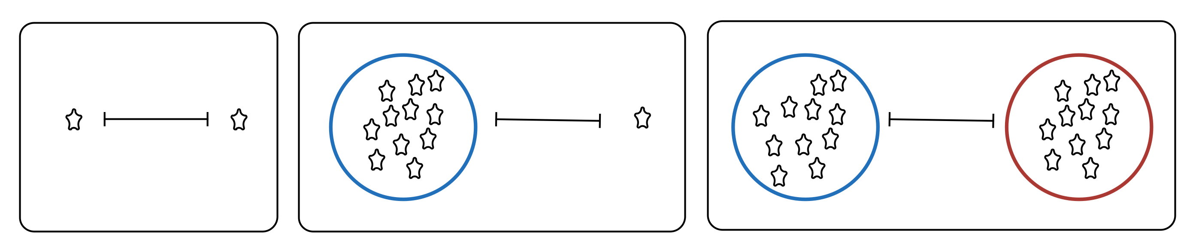
Function Components
There are a huge number of both of clustering and cluster validation functions
However, all are built up out of the basic measures relating to instance or cluster properties we have already reviewed:
Instance Properties
Cluster Properties
Instance – Instance Relationship Properties
Cluster – Instance Relationship Properties
Cluster – Cluster Relationship Properties

Slide 42
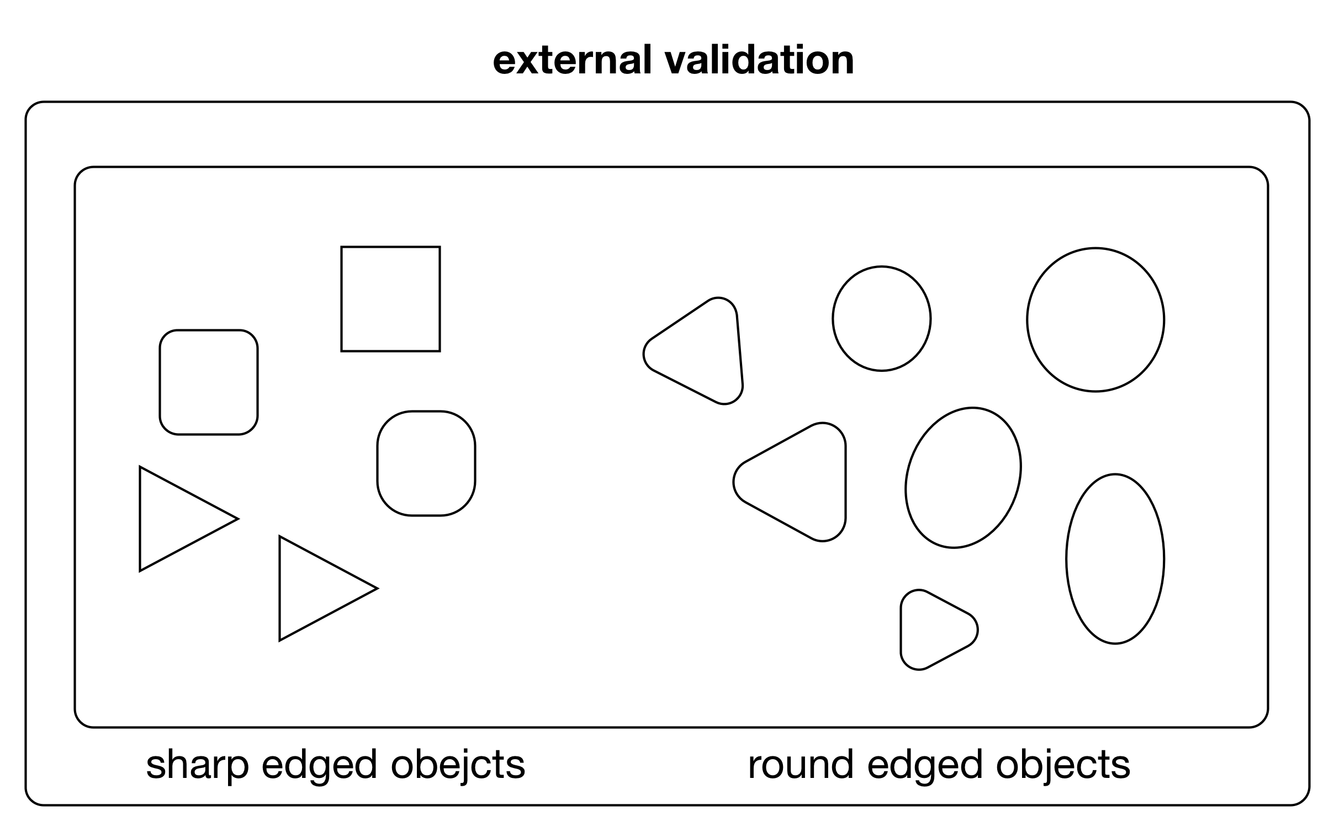
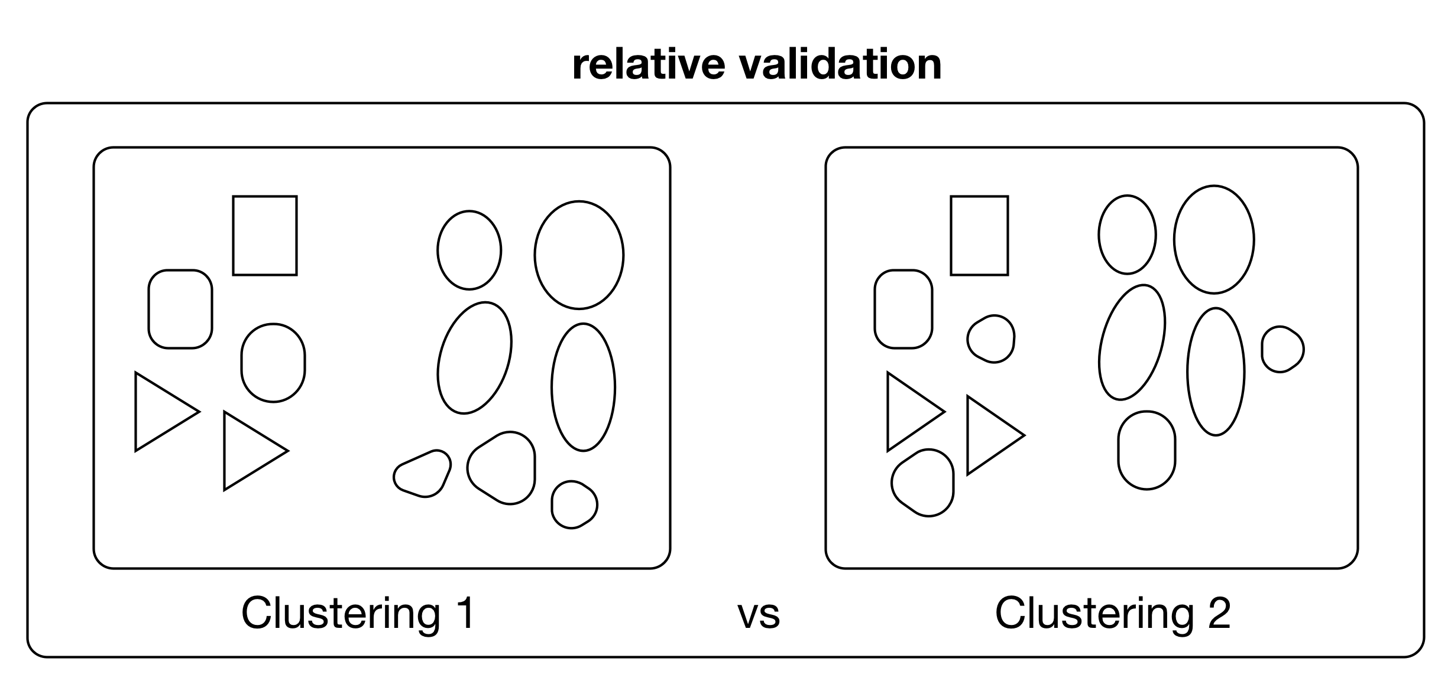
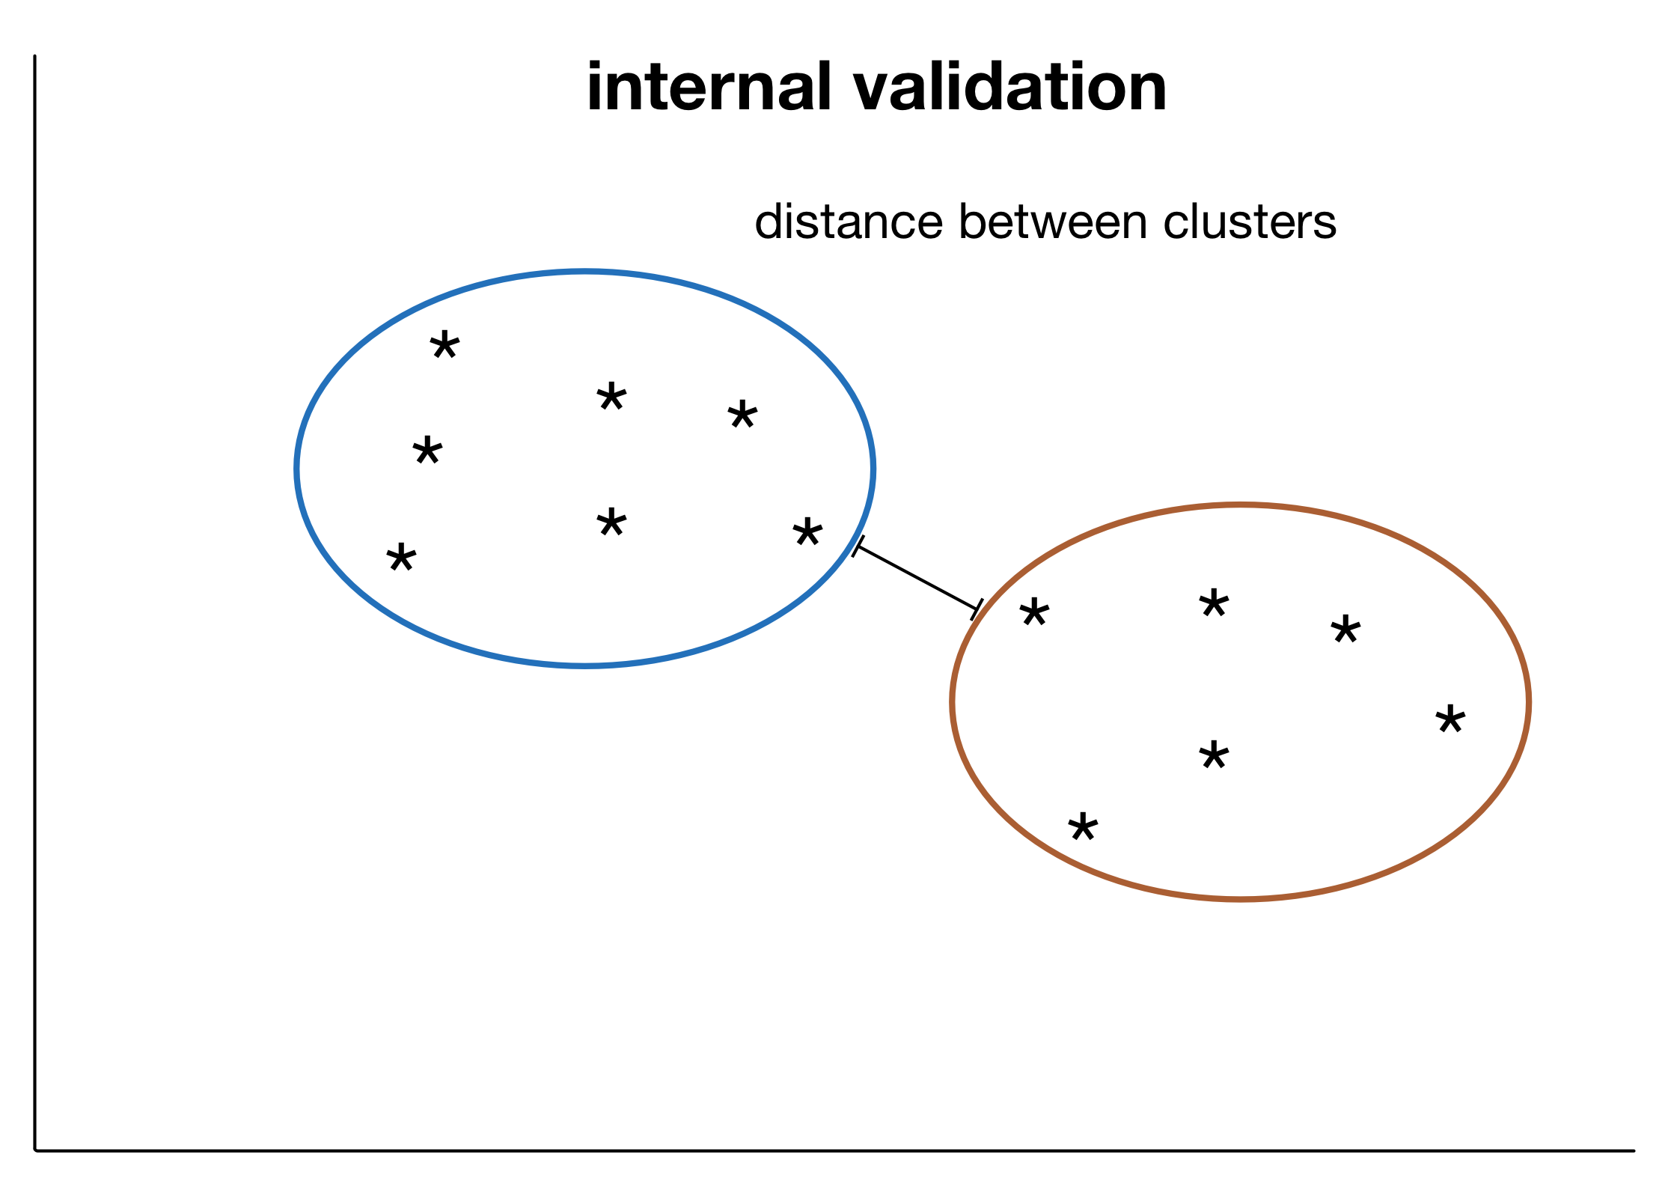
Three types of validation
Internal Validation: Based only on properties available within a single clustering result (note that this comprises multiple clusters)
Relative Validation: Comparison of one (entire) clustering result with another
External Validation: Comparison of a (single) clustering result with some external standard

Slide 43
Validity vs. Quality
Context is very relevant to the quality of a given clustering, but what if we have no context?
Is there a way to objectively measure cluster quality without any specific context?
The term ‘validity’ suggests there is a correct clustering, and all we need to do is see how close we are to that.
Alternatively Lewis, Ackerman and de Sa (2012) use the term Clustering Quality Measures (CQM) instead

Slide 44
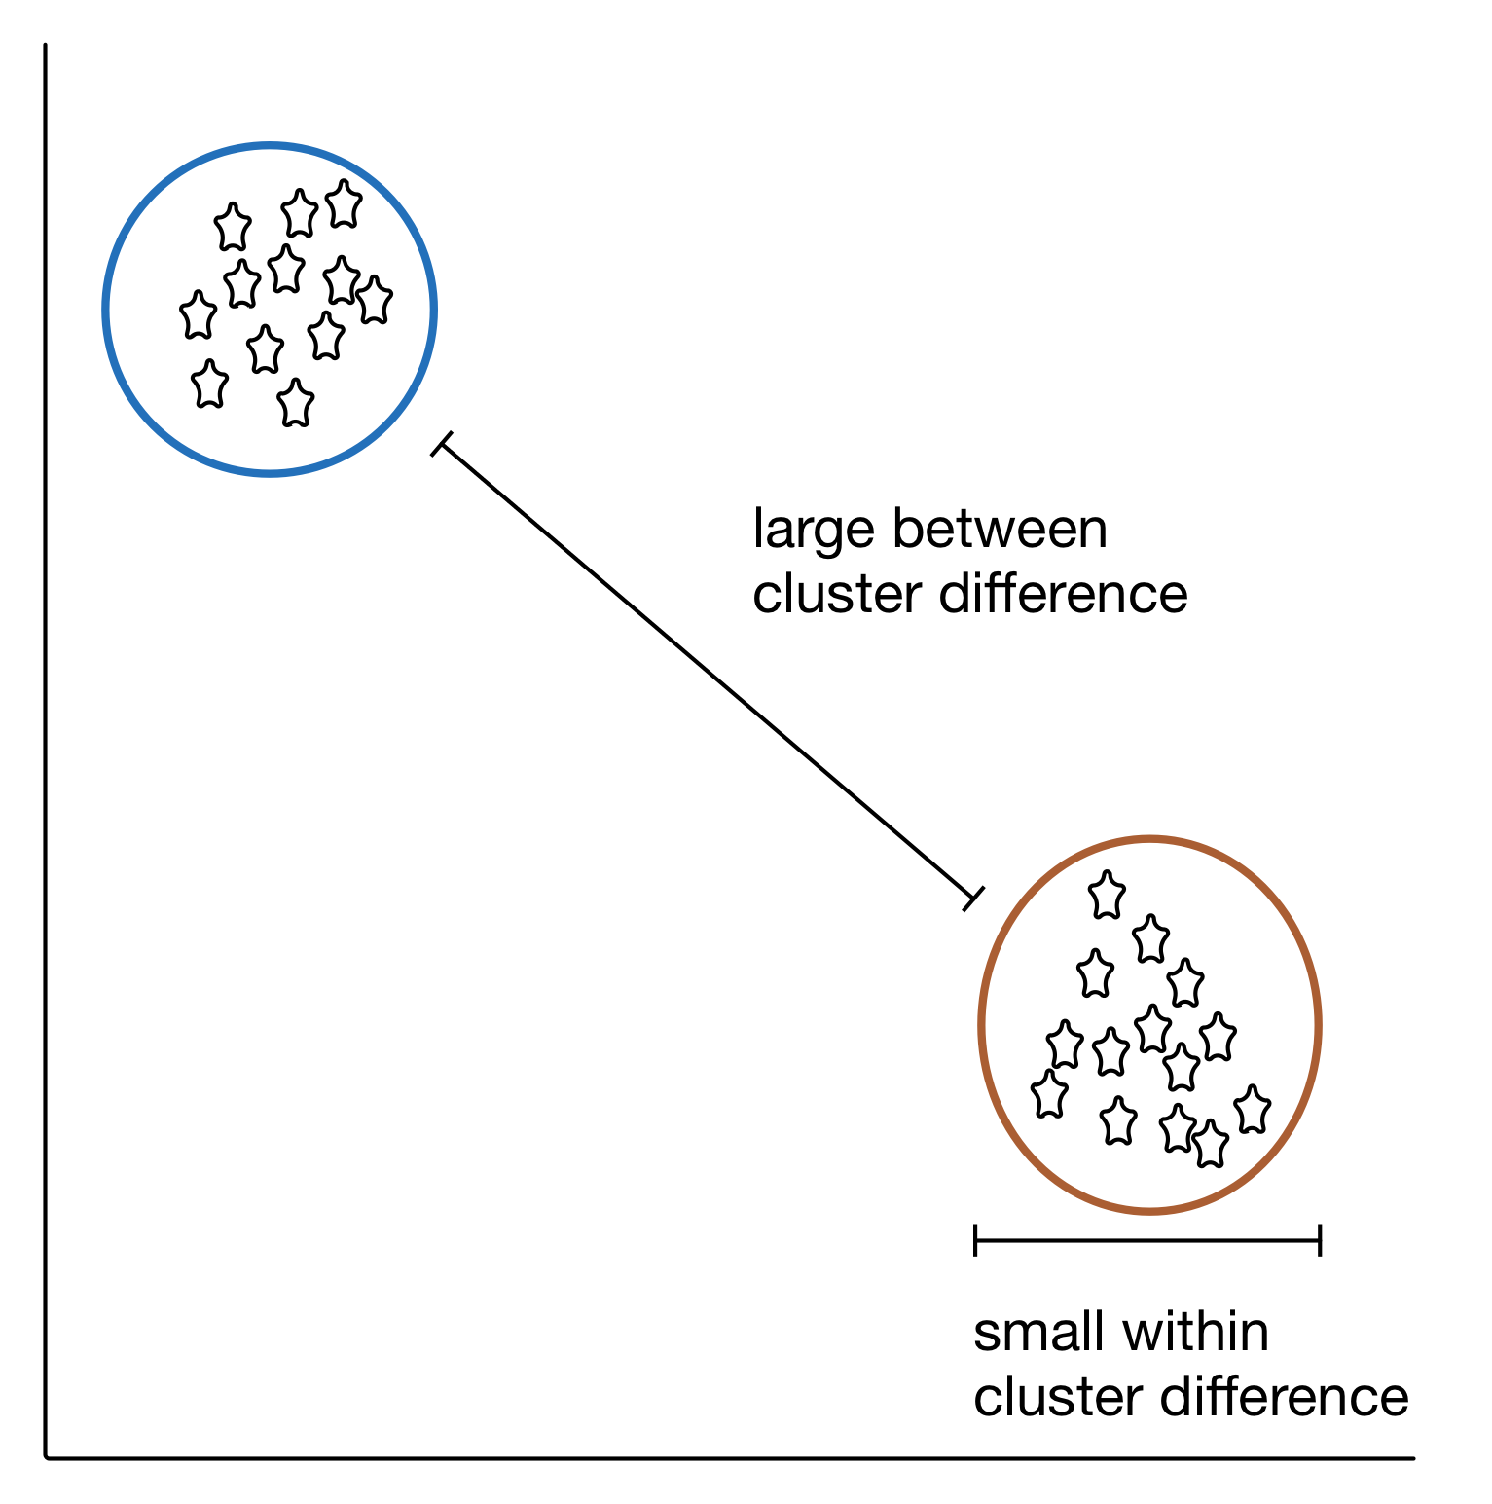
Very Broad Goals
Within clusters, everything is very similar. Between clusters, there is a lot of difference.
The problem: there are many ways for clusters to deviate from this ideal.
In specific clustering cases, how do we weigh the good aspects (e.g. high within cluster similarity) relative to the bad (e.g. low between cluster separation).
Thus the large number of CQMs.

Slide 45
Very Broad Goals
Question: is this trade-off (and the resulting CQMs) really context independent?
Maybe different weightings are more relevant in different contexts?

Slide 46
Silhouette Index
A strong internal validation metric that incorporates a number of measures.

Slide 47
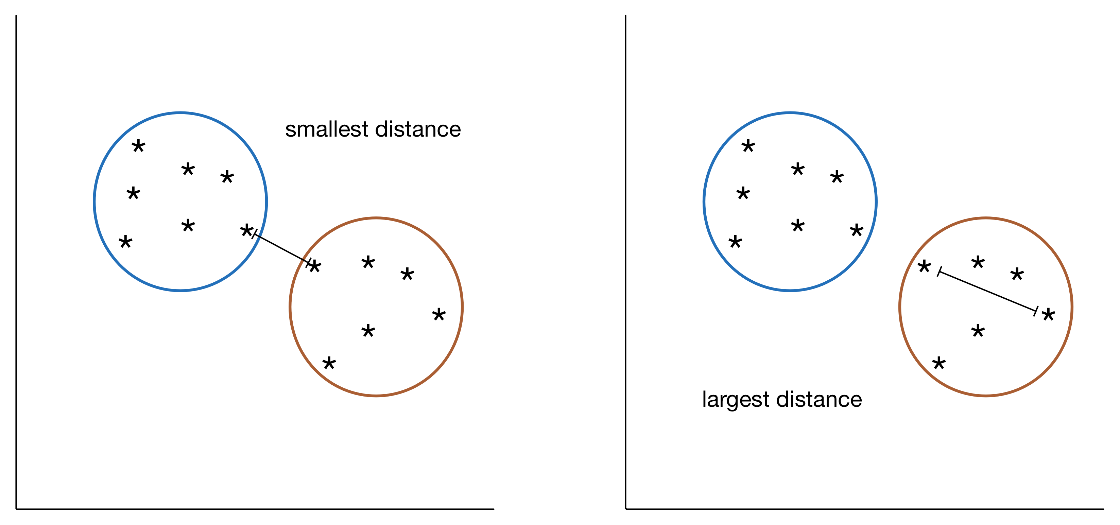
Dunn’s Index
Within a cluster, the size of the cluster (e.g. greatest distance between points.
Between two clusters, the distance between the clusters (e.g. minimum distance between points).
Ratio: The minimum intercluster distance across all pairs of clusters / maximum intracluster distance across all clusters.
A number of possible ways to define inter cluster distance and cluster size.
Comparison with Silhouette Index: In a sense, a simpler measure. More of a whole cluster measure, rather than a point by point measure. Evaluates based on extremes (max, min).

Slide 48
More is better (RELATIVE)?
Getting a single validation measure for a single clustering is not that useful – could the results be better? Is this the best we can hope for?
How about comparing results across runs or parameter settings?
Main emphasis with relative validation is how to compare results of individual runs.

Slide 49
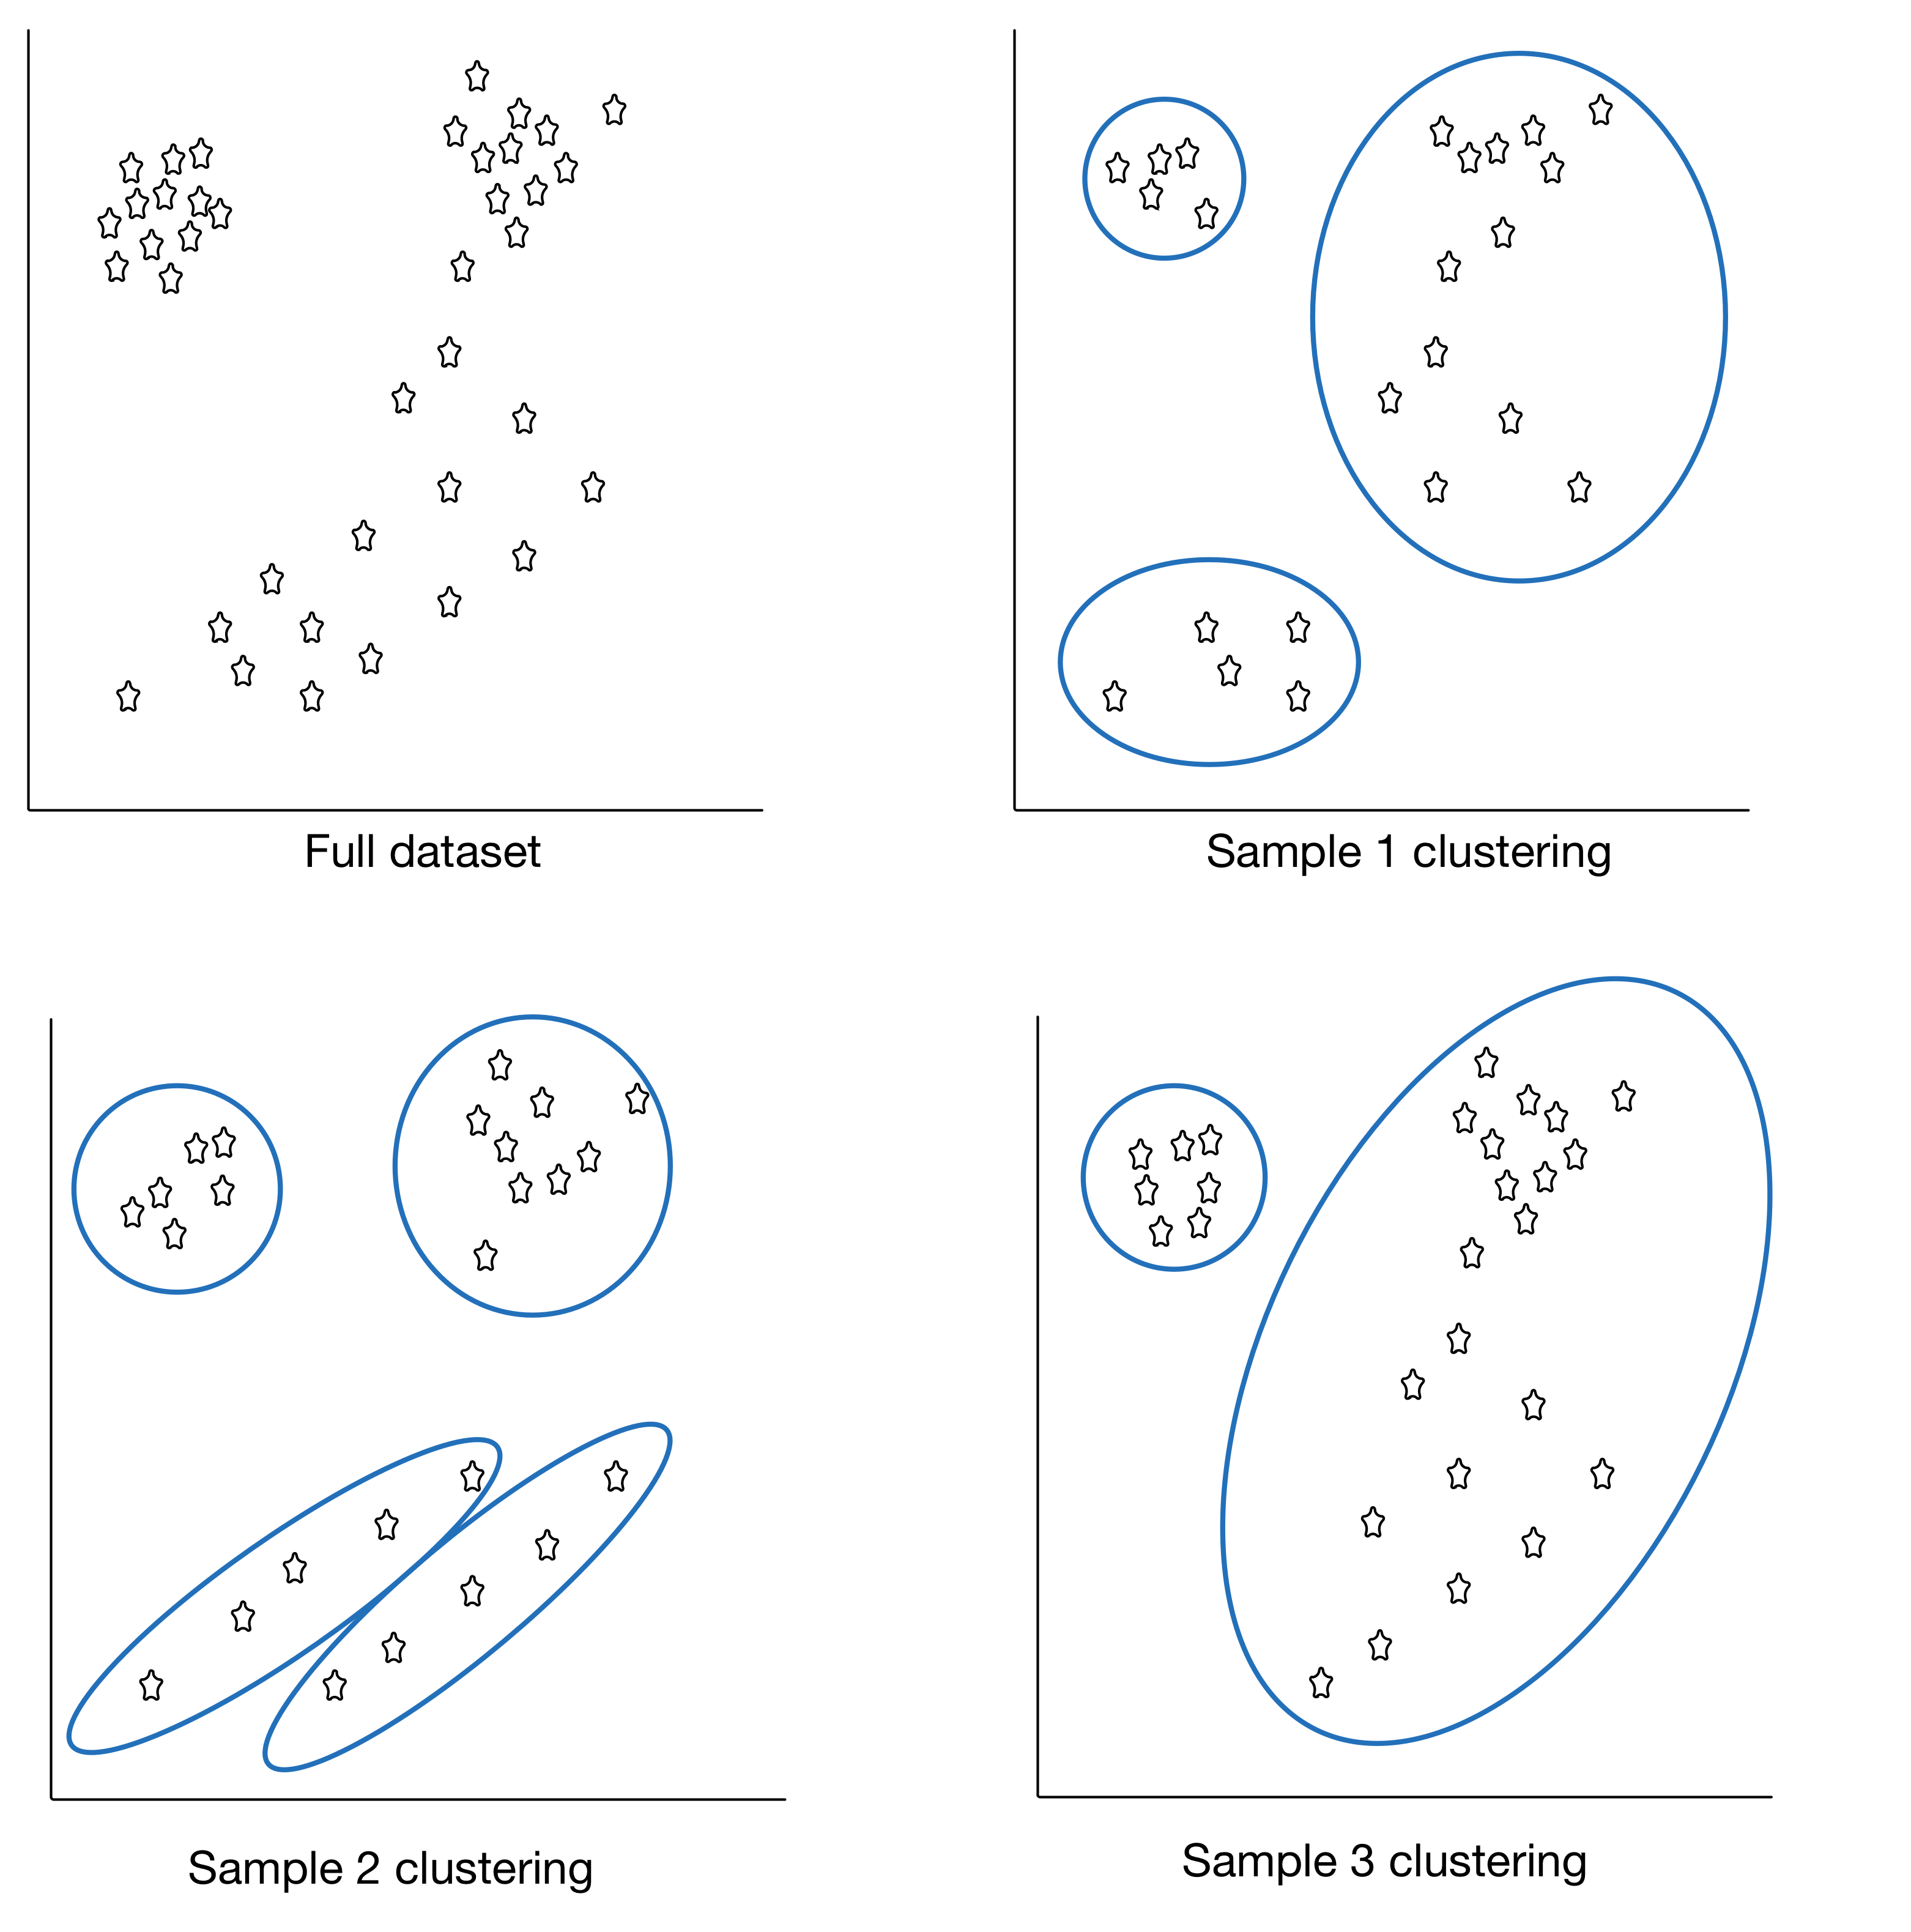
Stability
Some options:
multiple datasets sampled from same source
different columns used to generate clusters (i.e. drop a different column each time)
Similarity of results is measured.
If results are not stable across clusterings, further investigation required.

Slide 50
Back to Context (EXTERNAL)
Brings in outside information to evaluate the clusters.
Outside information is typically the ‘correct’ class.
How is this different from classification then?
Often used to build confidence in the overall approach, based on preliminary or sample results.

Slide 51
Purity (EXTERNAL)
For this metric each cluster is assigned to the class which is most frequent in the cluster.
To calculate the purity: number of correctly assigned points / number of points in the cluster.
Some other options: precision, recall.

Slide 52
Try and Try Again
Diversity in clustering validation techniques.
Be aware of the types of validation, and variations within types.
Seek agreement across techniques.
There are many ways for a clustering to be ‘ok’ – you need to decide what is important and what can be ignored.
A lot depends on context.

Slide 53
Notes
CLUSTERING
“Woes clusters. Rare are solitary woes; they love a train, they tread each other’s heel”
(Edward Young)

Slide 54
Clustering Challenges
Automation relatively intuitive for humans, but hard to automate
Lack of a clear-cut definition no universal agreement as to what constitutes a cluster
Lack of repeatability non-deterministic: the same algorithm, applied twice to the same dataset can discover completely different clusters
Number of clusters optimal number of clusters difficult to determine

Slide 55
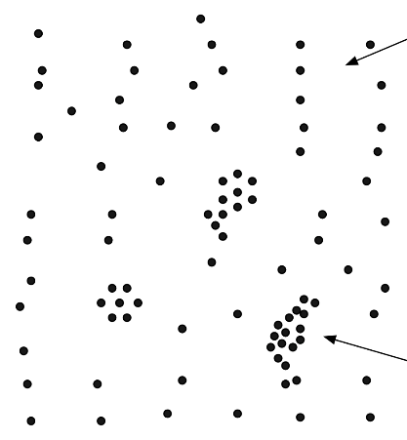

Slide 58
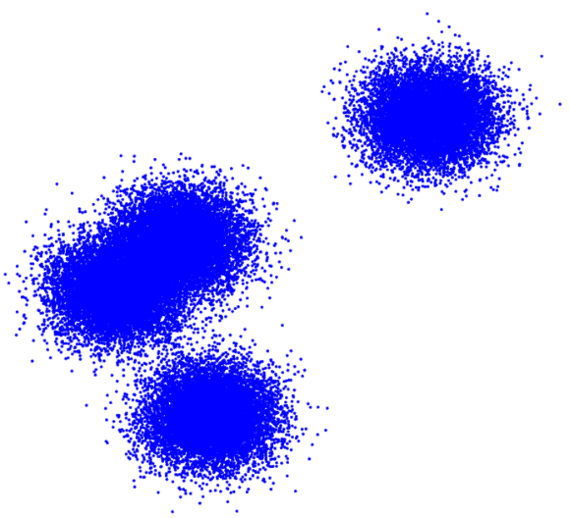

Slide 59
Clustering Challenges
Cluster description should clusters be described using representative instances or average values?
Model validation no true clustering information against which to contrast the clustering scheme, so how do we determine if it is appropriate?
Ghost clustering most methods will find clusters even if there are none in the data
A posteriori rationalization once clusters have been found, it is tempting to try to "explain" them …

Slide 60
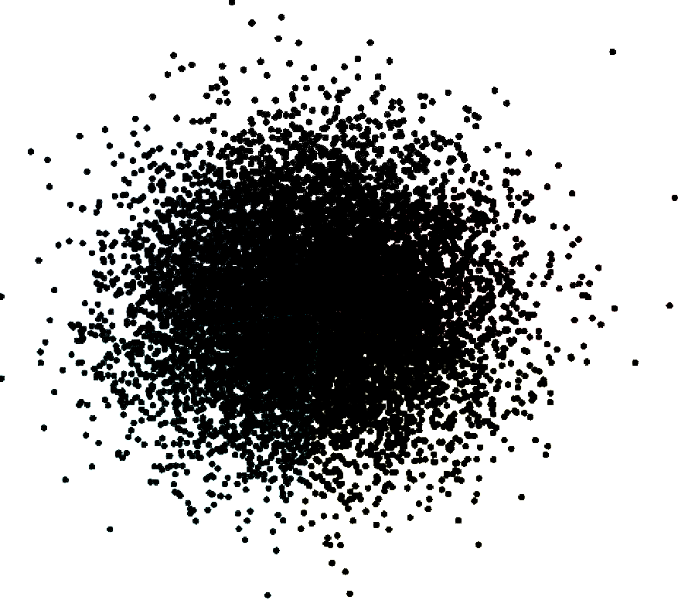

Slide 61
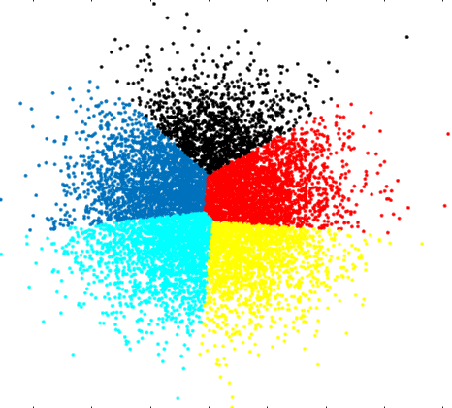

Slide 62
Example: Irises
CLUSTERING
“Data science students don’t have to be gardeners, but it helps.”
(author unknown)

Slide 63
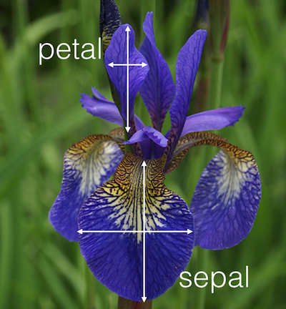
Example – Iris Dataset
[http://blog.kaggle.com/wp-content/uploads/2015/04/iris_petal_sepal.png]
Iris is a genus of plants with showy flowers.
Fisher’s iris dataset contains 150 observations of 5 attributes for specimens collected by Anderson, mostly from a Gaspé peninsula’s pasture in the 1930s:
petal width
petal length
sepal width
sepal length
species

Slide 64
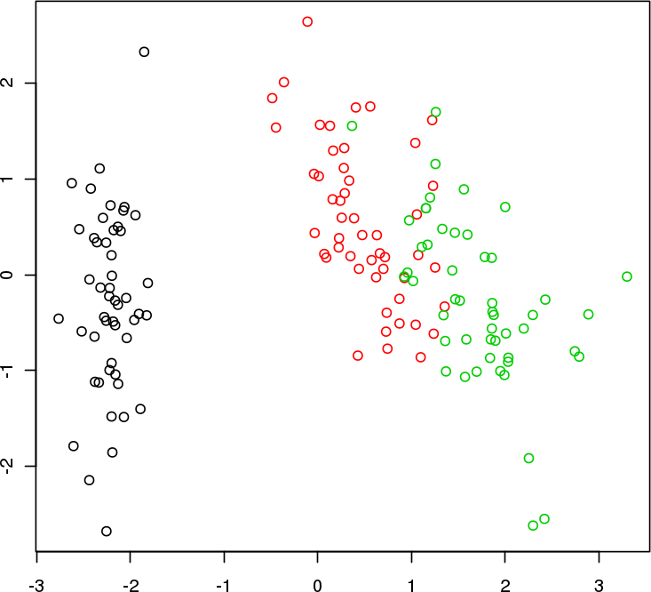
Example – Iris Dataset
PC2
Iris Classification
PC1

Slide 65
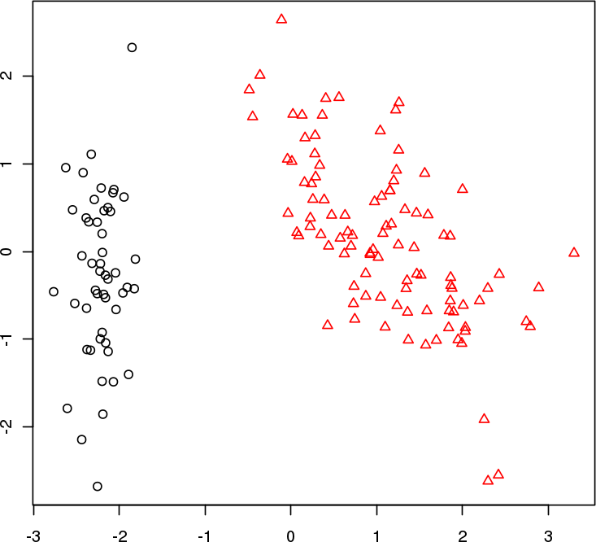
Example – Iris Dataset
PC2
2 Clusters
PC1

Slide 66
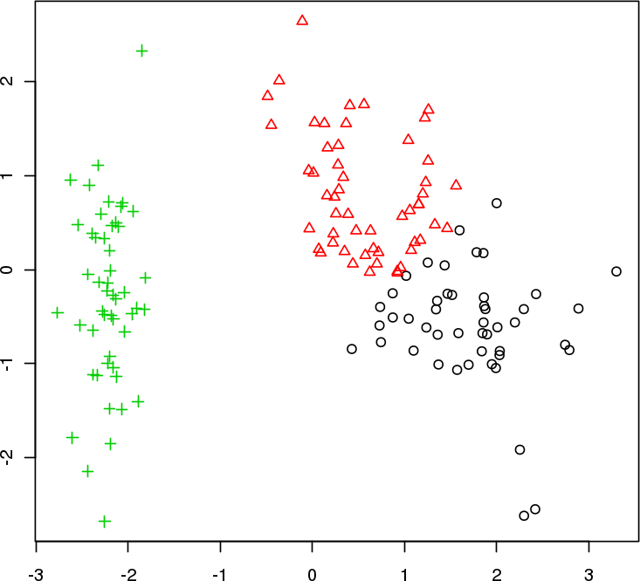
Example – Iris Dataset
PC2
3 Clusters
PC1

Slide 67
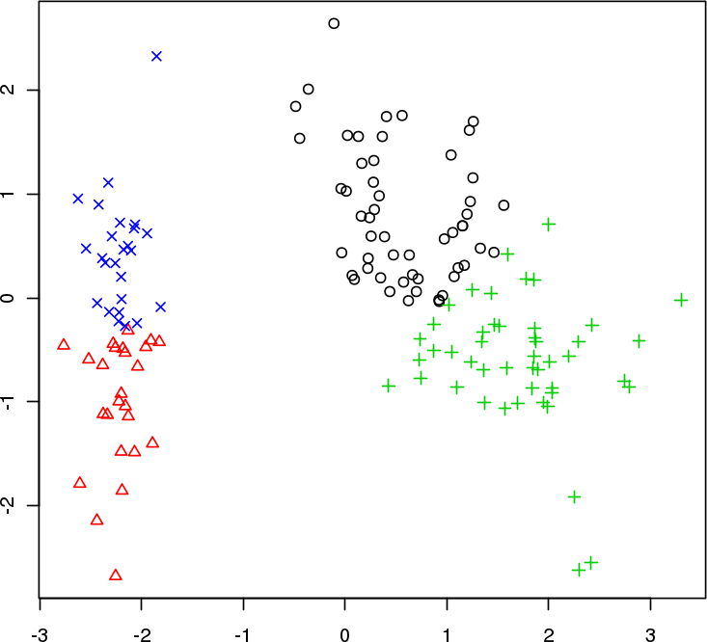
Example – Iris Dataset
PC2
4 Clusters
PC1

Slide 68
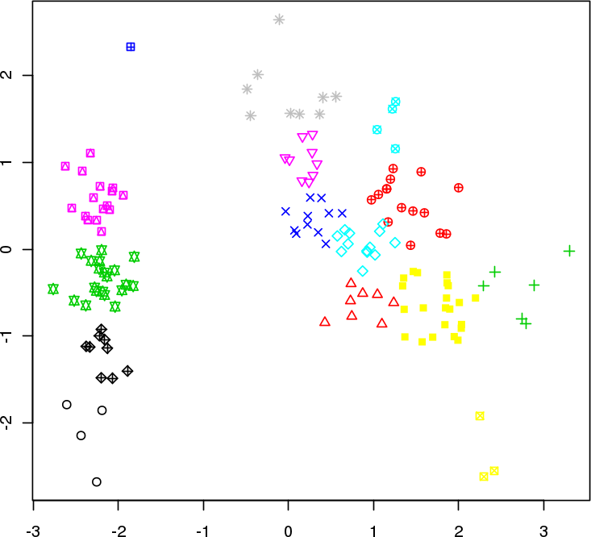
Example – Iris Dataset
PC2
15 Clusters
PC1

Slide 69
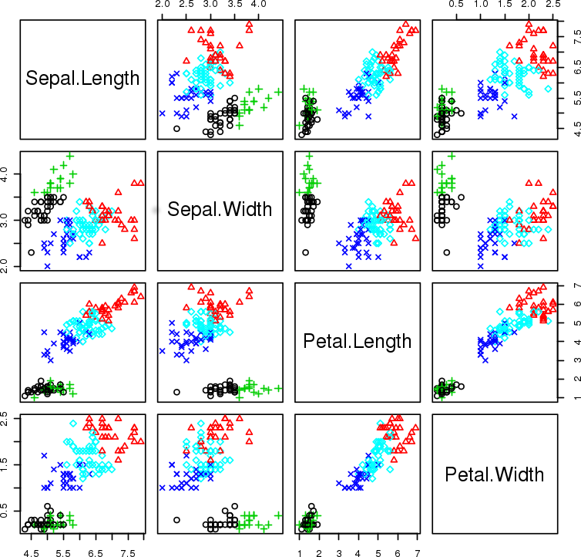
Example – Iris Dataset
5 clusters (1 replicate)

Slide 70
DISCUSSION
Is this a good clustering model?
Notes:
Intro to text analysis
We will be talking about data reduction using NHL game between Ottawa Senators vs. Toronto Maple Leafs on February 18th of 2017

Slide 71
References
CLASSIFICATION AND VALUE ESTIMATION

Slide 72
Supplemental Material
Hierarchical Clustering https://www.data-action-lab.com/wp-content/uploads/2019/03/Hierarchical-Clustering.pdf
DBSCAN https://www.data-action-lab.com/wp-content/uploads/2019/03/Density-Based-Clustering.pdf
Spectral Clustering https://www.data-action-lab.com/wp-content/uploads/2019/03/Spectral-Clustering.pdf
Clustering Notebooks https://www.data-action-lab.com/wp-content/uploads/2019/03/ClusteringNotebooks.zip

Slide 73
References
https://en.wikipedia.org/wiki/Davies–Bouldin_index
https://algobeans.com/2015/11/30/k-means-clustering-laymans-tutorial/
http://www.cs.umd.edu/~samir/498/10Algorithms-08.pdf
Aggarwal, C.C., Reddy, C.K. (eds.) [2014], Data Custering: Algorithms and Applications, CRC Press.
Torgo, L. [2017], Data Mining with R: Learning with Case Studies (2nd ed.), CRC Press
Aggarwal, C.C. [2015], Data Mining: the Textbook, Springer
Maheshwari, A.K. [2015], Business Intelligence and Data Mining, Business Expert Press.
Leskovec, J., Rajamaran, A., Ullman, J.D. [2014], Mining of Massive Datasets, Cambridge Press.

Slide 74
References
Provost, F., Fawcett, T. [2013], Data Science for Business, O'Reilly.
Hastie, T., Tibshirani, R., and J. Friedman [2008], The Elements of Statistical Learning: Data Mining, Inference, and Prediction, 2nd ed., Springer.
Frank, E., Witten, I.H. [2005], Data Mining: Practical Machine Learning Tools and Techniques, 2nd ed., Elsevier.
https://en.wikipedia.org/wiki/Cluster_analysis

Slide 75
References
hclust {stats}, R Documentation: Hierarchical Clustering, from Package stats version 3.3.0., by R Core Team and contributors worldwide. Retrieved 2016.10.11
Wikipedia: Hierarchical clustering. Last edited 2016-09-16. Retrieved 2016.10.11.
Hierarchical agglomerative clustering, in Introduction to Information Retrieval, by C.D. Manning, P. Raghavan and H. Schütze. Published (online version) 2009.04.07
Hierarchical Clustering with R (feat. D3.js and Shiny), by R. Vogler. Published 2014-12-14. Retrieved 2016.10.11.
Introduction to Visualizing Hierarchies, by R. Mazza, D. Brodbeck, M. Lanza and R. Wettel. Retrieved 2016.10.11.
Hierarchical cluster analysis, in Multivariate Analysis of Ecological Data, by M. Greenacre and R. Primicerio. Published 2013, by Fundación BBVA, 2013, Plaza de San Nicolás, 4 48005 Bilbao.
TIBCO Spotfire Documentation: What is a Treemap? Last edited: 2015-02-12. Retrieved 2016.10.11.

Slide 76
References
Wikipedia: Silhouette (clustering). Last edited 2016-07-15. Retrieved 2016.10.11.
silhouette {cluster} Compute or Extract Silhouette Information from Clustering, from Package cluster version 2.0.3, by M. Maechler, P. Rousseeuw, A. Struyf and M. Hubert. Published 2016-10-08.
Relative Clustering Validity Criteria: A Comparative Overview by L. Vendramin, R.J.G.B. Campello and E.R. Hruschka. Published online 2010-06-30, by Wiley InterScience.
A General Coefficient of Similarity and Some of Its Properties, by J. C. Gower. Biometrics, 1971.
Dissimilarity Measures, in A Guide to Statistical Analysis in Microbial Ecology: a community-focused, living review of multivariate data analyses. by P.L. Buttigieg and A. Ramette.
Cosine similarity, Pearson correlation, and OLS coefficients, by B. O’Connor.
Data Mining Portfolio Similarity and Dissimilarity Measures, by G. Benoît.
Measures of distance and correlation between variables, in Multivariate Analysis of Ecological Data, by M. Greenacre and R. Primicerio. Published 2013.

Slide 77
References
Scientists Trace Society’s Myths to Primordial Origins, by J. d'Huy. In Scientific American (Online). Published 2016-09-29. Retrieved 2016-10-11.
Complex building’s energy system operation patterns analysis using bag of words representation with hierarchical clustering, by U. Habib, K. Hayat and G. Zucker. Complex Adaptive Systems Modeling, 2016, 4:8.
A Comparison of Antioxidant, Antibacterial, and Anticancer Activity of the Selected Thyme Species by Means of Hierarchical Clustering and Principal Component Analysis, by M. Orłowska, K. Pytlakowskae, A. Mrozek-Wilczkiewicz, R. Musioł, M. Waksmundzka-Hajnos, M. Sajewicz, T. Kowalska.Acta Chromatographica, 2016, 28.
Use of hierarchical cluster analysis to classify prisons in Ireland into mutually exclusive drug-use risk categories, by M. Codd, J. Mehegan, C. Kelleher, A. Drummond.
Divisive Analysis (DIANA) of hierarchical clustering and GPS data for level of service criteria of urban streets, by A.K. Patnai, P.K. Bhuyan, K.V.K. Rao.

Slide 78
References
Clusters and DBScan, by Jesse Johnson.Published 2013-08-20. Retrieved 2016.10.11.
Scikit Documentation: Comparing different clustering algorithms on toy datasets. By scikit-learn developers. Retrieved 2016.10.11.
Data Mining TNM033 Notes: DBSCAN A Density-Based Spatial Clustering of Application with Noise, by Henrik Bäcklund, Anders Hedblom and Niklas Neijman. Published 2011-11-30. Retrieved 2016.10.11.
Scatterplot3d: an R package for Visualizing Multivariate Data, by Uwe Ligges and Martin Mächler. Published 2003. Retrieved 2016.10.11.
Wikipedia article for DBSCAN
Schubert, Erich; Sander, Jörg; Ester, Martin; Kriegel, Hans Peter; Xu, Xiaowei (July 2017). "DBSCAN Revisited, Revisited: Why and How You Should (Still) Use DBSCAN“, ACM Trans. Database Syst. 42 (3): 19:1–19:21. doi:10.1145/3068335, ISSN 0362-5915

Slide 79
References
Automated detection of brain atrophy patterns based on MRI for the prediction of Alzheimer's disease, by C. Plant, S.J. Teipel, A. Oswald, C. Böhm, T. Meindl, J. Mourao-Miranda, A.W. Bokde, H. Hampel, M. Ewers.
A Novel Approach for Predicting the Length of Hospital Stay With DBSCAN and Supervised Classification Algorithms, by Panchami V.U., N. Radhika, A.V. Vidyapeetham.
Simulation of DNA damage clustering after proton irradiation using an adapted DBSCAN algorithm, by Z. Francis, C. Villagrasa, I. Clairand.
Where traffic meets DNA: mobility mining using biological sequence analysis revisited, by A. Jawad, K. Kersting, N.V. Andrienko.
Individual movements and geographical data mining. clustering algorithms for highlighting hotspots in personal navigation routes, by G. Schoier, G. Borruso.

Slide 80
References
Ulrike von Luxburg, A Tutorial on Spectral Clustering, Max Planck Institute for Biological Cybernetics
Aarti Singh, Spectral Clustering.
Andrew Y. Ng, Michael I. Jordan, Yair Weiss, On Spectral Clustering: Analysis and an Algorithm.
Jing Wang, An Introduction to Support Vector Machine and Spectral Clustering.
Lihi Zelnik-Manor, Pietro Perona, Self-Tuning Spectral Clustering.
Denis Hamad, Philippe Biela, Introduction to spectral clustering.
Marina Meila, Classic and Modern Data Clustering
H.T. Kung, Dario Vlah, A Spectral Clustering Approach to Validating Sensors via Their Peers in Distributed Sensor Networks
Morteza Chehreghani, Alberto Busetto, Joachim Buhmann, Information Theoretic Model Validation for Spectral Clustering
Sepandar D. Kamvar, Dan Klein, Christopher Manning, Spectral Clustering

Slide 81
References
Vendramin, L. & J. G. B. Campello, R. & Hruschka, E. (2010). Relative clustering validity criteria: A comparative overview. Statistical Analysis and Data Mining. 3. 209-235. 10.1002/sam.10080.
Amigó, E. & Gonzalo, J. & Artiles, J. & Verdejo, M. (2009). Comparison of extrinsic clustering evaluation metrics based on formal constraints. Information Retrieval. 12. 461-486.
M Lewis, J. & Ackerman, M. & de Sa, V. (2012). Human Cluster Evaluation and Formal Quality Measures: A Comparative Study. Proc. 34th Conf. of the Cognitive Science Society.
Bernard Desgraupes (2013). Clustering Indices. Lab Modal’X, University Paris Ouest.
Justin Cranshaw, Raz Schwartz, Jason I. Hong, and Norman Sadeh, “The Livehoods Project: Utilizing Social Media to Understand the Dynamics of A City,” Proceedings of the the Sixth International AAAI Conference on Weblogs and Social Media (ICWSM–12), Dublin, Ireland, pp. 1–8, 2012.
Kung H. T., Vlah D.A, “Spectral clustering approach to validating sensors via their peers in distributed sensor networks”, Proceedings of the 18th IEEE International Conference on Computer Communications and Networks (ICCCN '09), 2009.

Slide 82
SUPPLEMENTAL MATERIAL
CLUSTERING

Slide 83
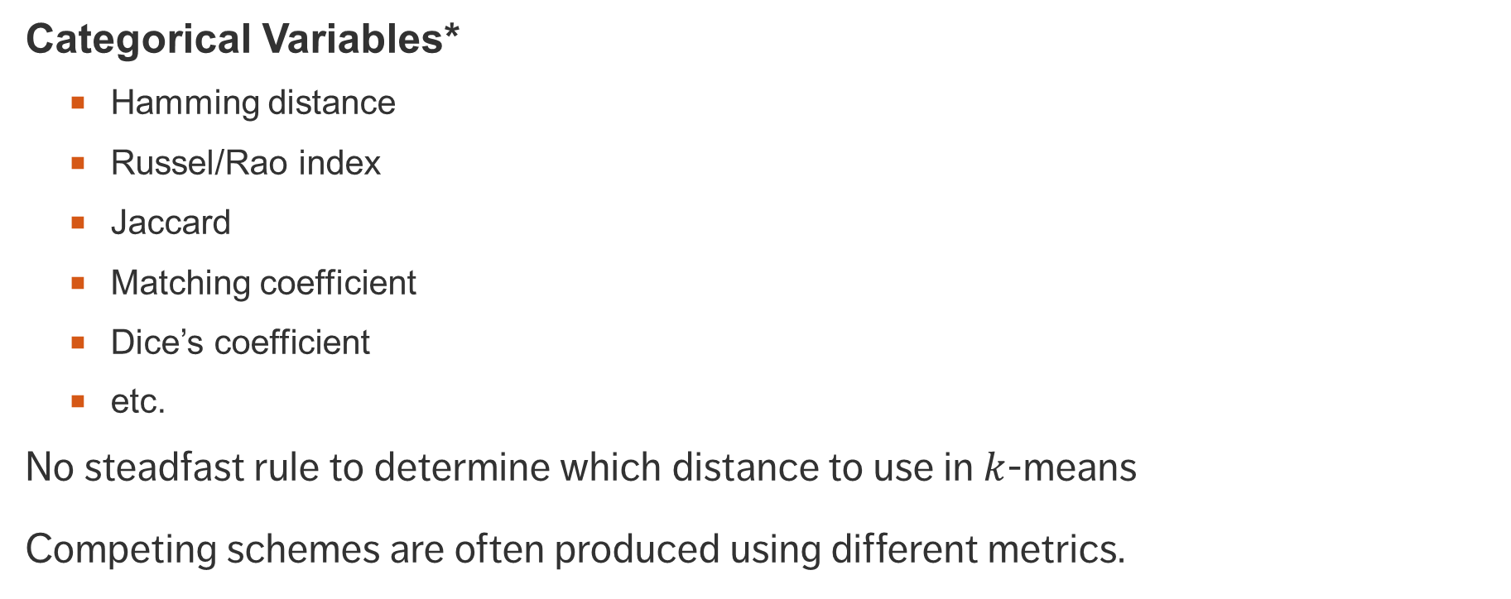
Distance Measures (Metrics)
* may need to be dichotomized
Numerical Variables*
Euclidean
Manhattan
Correlation
Cosine
Pearson
etc.
Categorical Variables*
Hamming distance
Russel/Rao index
Jaccard
Matching coefficient
Dice’s coefficient
etc.
No steadfast rule to determine which distance to use in $k$-means
Competing schemes are often produced using different metrics.

Slide 84
Clustering Validation
What does it mean for a clustering scheme to be better than another?
What does it mean for a clustering scheme to be valid?
What does it mean for a single cluster to be good?
How many clusters are there in the data, really?
Right vs. wrong is meaningless: seek optimal vs. sub-optimal.

Slide 85
Clustering Validation
Optimal clustering scheme:
maximal separation between clusters
maximal similarity within groups
agrees with human eye test
useful at achieving its goals
Validation types
external (uses additional information)
internal (uses only the clustering results)
relative (compares across clustering attempts)

Slide 86
DISCUSSION
The main clustering challenge is that we don’t know what we are comparing the resulting clustering scheme against (versions of this problem plague unsupervised tasks).
So why bother with clustering in the first place?
Notes:
Intro to text analysis
We will be talking about data reduction using NHL game between Ottawa Senators vs. Toronto Maple Leafs on February 18th of 2017

Slide 87
A (Small?) Sample of Internal CQMs
Gplus
KsqDetW
LogDetRatio
LogSSRatio
McClain-Rao
PBM
Point-Biserial
Ratkowsky-Lance
Ray-Turi
Scott-Symons
SD
SDbw
Silhouette
Tau
Trace
TraceWiB
Wemmert-Gancarski
Xie-Beni
Ball-Hall
Banfeld-Raftery
C
Calinski-Harabasz
Davies-Bouldin
Det Ratio
Dunn
Baker-Hubert Gamma
GDI
What are we to make of all these different, supposedly context-free measures of clustering quality?
(available in R via clusterCrit)

Slide 88
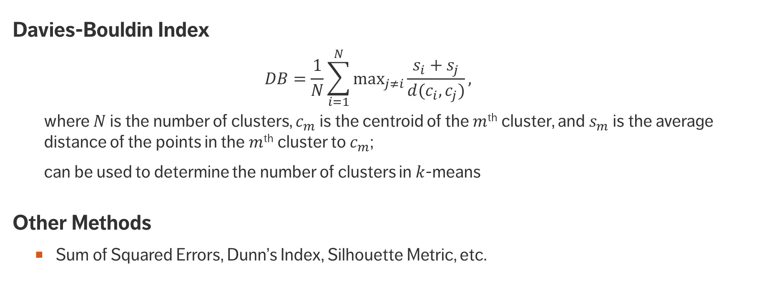
Internal Clustering Validation
Davies-Bouldin Index
$$DB=\frac{1}{N}\sum_{i=1}^{N}{\max_{j≠i}{\frac{s_{i}+s_{j}}{d(c_{i}, c_{j})}}},$$ where $N$ is the number of clusters, $c_{m}$is the centroid of the $m$^{th} cluster, and $s_{m}$ is the average distance of the points in the $m$^{th} cluster to $c_{m}$;
can be used to determine the number of clusters in $k$-means
Other Methods
Sum of Squared Errors, Dunn’s Index, Silhouette Metric, etc.

Slide 89
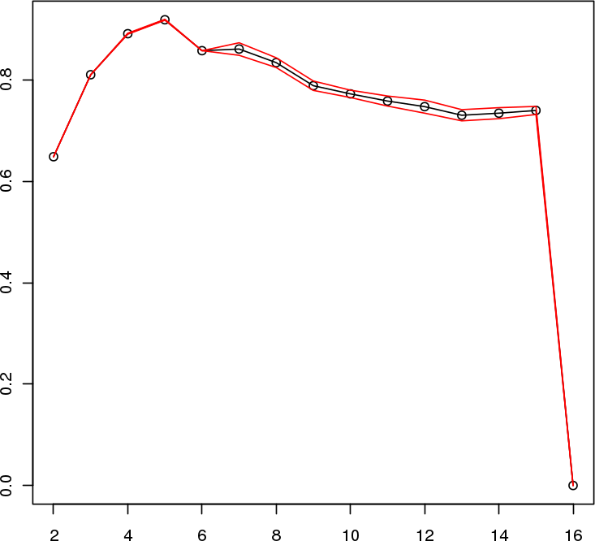
Example – Iris Dataset
Davies-Bouldin Index (variant)
# of clusters

Slide 90
Example – Iris Dataset
Davies-Bouldin Index (variant)
# of clusters

Slide 91
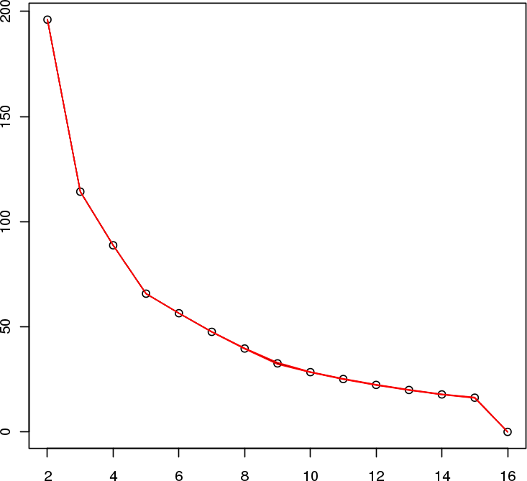
Example – Iris Dataset
Sum of Squared Errors
# of clusters

Slide 92
Example – Iris Dataset
Sum of Squared Errors
# of clusters

Slide 93
Comparing measures across datasets
Vendramin et al 2010 used a number of benchmark tests to compared a large number of intrinsic validation measures.
Broad conclusion: variants of Silhouette performed well across tests.

Slide 94
Machine Learning vs Human Learning
Lewis et al compare 6 common CQMs with human evaluation of clustering results
Main finding: Human clustering evaluation was most similar to Silhouette and Calinski-Harabasz
Maybe internal validation/CQM is saying something about clustering across all contexts?
Maybe easier to identify the clearly bad than all the variations of good?

Slide 95
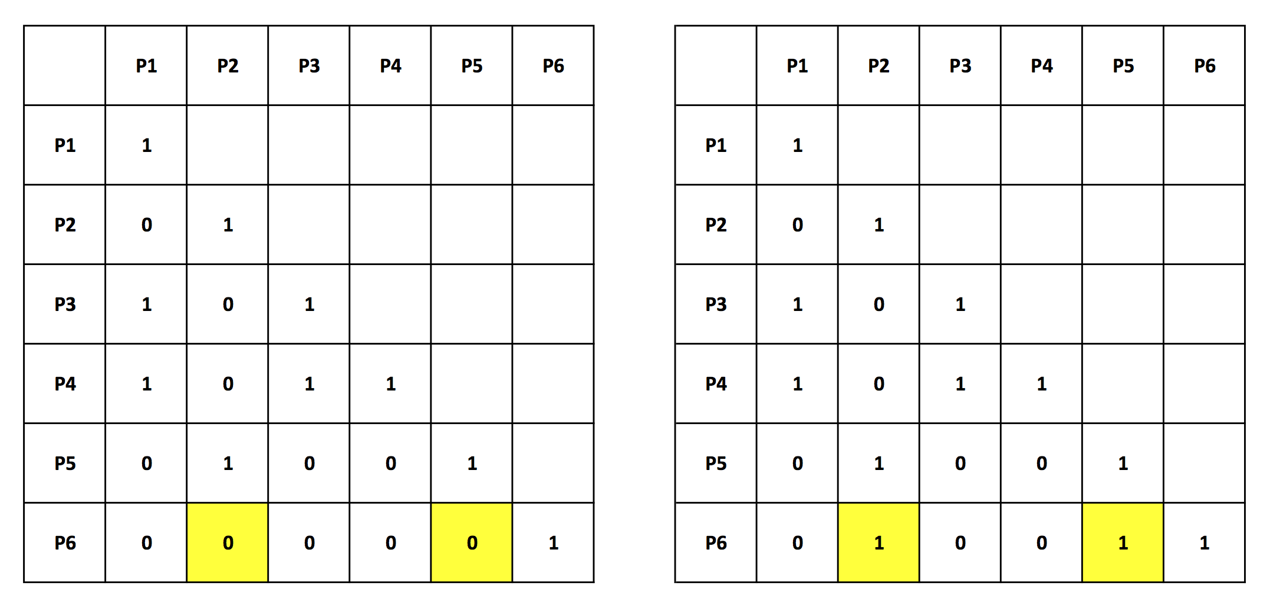
Correlation Measures
Look at correlation between clustering assignments
Rand, Jaccard, Gamma
Perfect correlation gives maximum value of the measure
Two very similar clustering results
(but notice they vary in the number of clusters).

